Slide 1

Tips for Seller Success this Christmas and beyond
Confidential © 1996-2011, Amazon.com, Inc. or its affiliates. All rights reserved.

Slide 2
Agenda
  Analysing your sales with Business Reports
  Getting your products discovered
  Planning for the rush
  Keeping customers in mind
  Summary
  Q&A
  Useful References

Slide 3
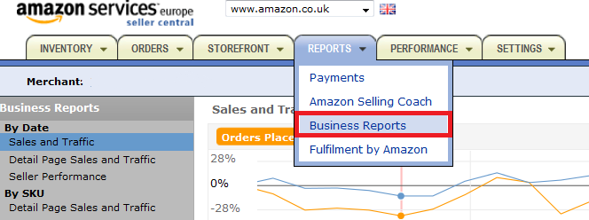
Analysing your sales with Business Reports
Where to find them
Business Reports (also called ‘Site Metrics’) are located in the Reports section of Seller Central.
They allow you to monitor your sales performance on Amazon with 2 main types of reports:
By Date: aggregated sales and traffic data over a period of time
By SKU: sales and traffic data per product in your inventory over a period of time
Notes:
Vous restez le propriétaire de votre stock et le vendeur officiel tandis qu’Amazon assure l’intendance.
Vous disposez d’un accès en temps réel aux informations et aux rapports sur votre stock via notre outil Web.
Vous gardez la maîtrise de tous les aspects liés à la vente : gestion des offres, description et tarification des produits.

Slide 4
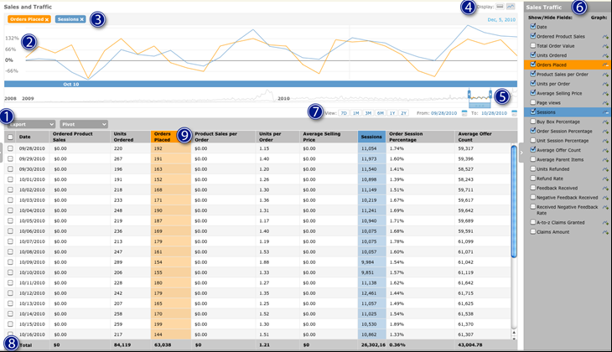
Analysing your sales with Business Reports
Identify sales trends with ‘By Date’ reports
Legend:
Menu bar 4. Toggle Display 7. View short cuts
Graph 5. Date range selector 8. Totals
Graph key 6. Right navigation bar 9. Column headers
Notes:
Vous restez le propriétaire de votre stock et le vendeur officiel tandis qu’Amazon assure l’intendance.
Vous disposez d’un accès en temps réel aux informations et aux rapports sur votre stock via notre outil Web.
Vous gardez la maîtrise de tous les aspects liés à la vente : gestion des offres, description et tarification des produits.

Slide 5
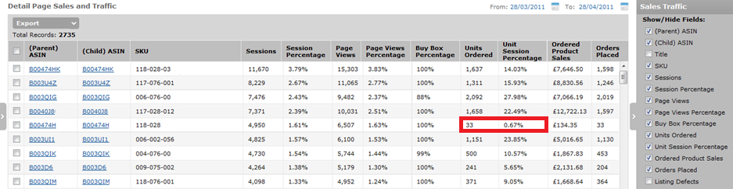
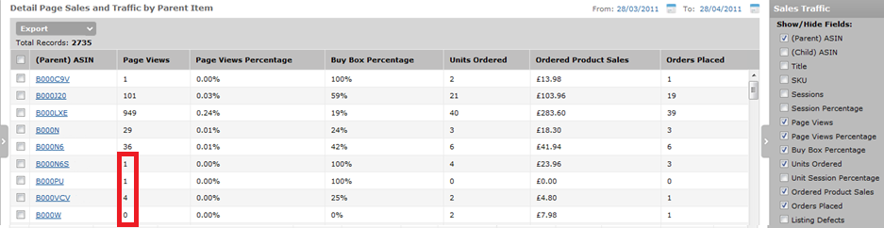
Analysing your sales with Business Reports
Identify best-sellers and slow-movers
This product is looked at by buyers, but your offer is not attractive enough to convert into sales:
Nobody is looking at your products, try to increase their visibility or reconsider your sourcing:

Slide 6
Agenda
  Analysing your sales with the Business Reports
  Getting your products discovered
  Planning for the rush
  Keeping customers in mind
  Summary
  Q&A
  Useful References

Slide 7
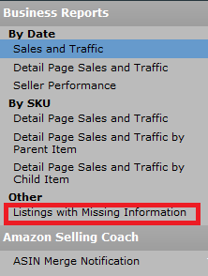
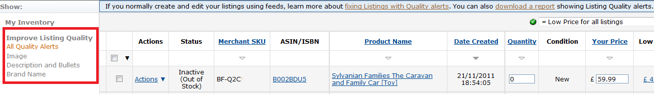
Getting your products discovered
Complete your listings information
From the Business Reports, you can access the ‘Listings with Missing Information’ report:
Incomplete information will make buyers hesitant about purchasing your products

Slide 8
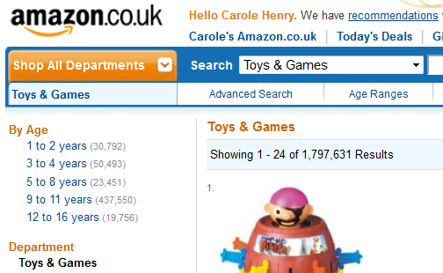
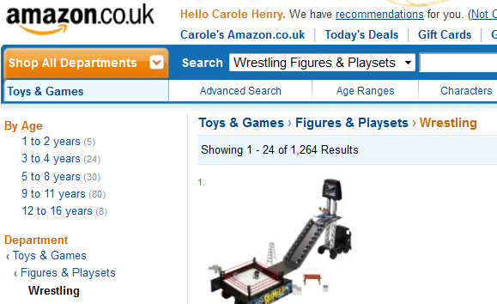
Getting your products discovered
Add browse nodes
Having a correct Browse Node makes it easier for buyers to find your products when they browse through the Amazon navigation tree structure:
No browse node or a very high level browse node means your product might get lost in the crowd
A precise browse node means people looking for your type of products are more likely to see your item in their search results

Slide 9
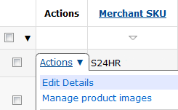
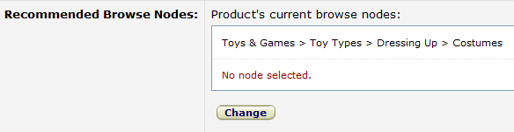


Getting your products discovered
Add browse nodes
You can add browse nodes one by one by going into ‘Edit Details’ in ‘Manage inventory’:
You can also add nodes in bulk when uploading your products with inventory files:
Download the Browse Tree Guide for your product category
Find the best node for your product (avoid grey ‘high level’ nodes)
Enter the corresponding number into your inventory file

Slide 10
Agenda
  Analysing your sales with the Business Reports
  Getting your products discovered
  Planning for the rush
  Keeping customers in mind
  Summary
  Q&A
  Useful References
2.3 million items were ordered on Amazon.co.uk on 6th December 2010, that is 27 items per second.

Slide 11
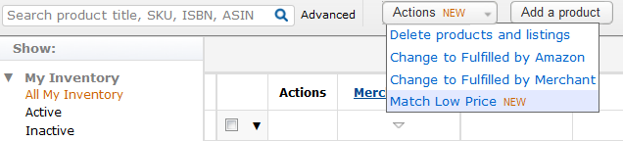
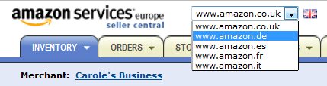
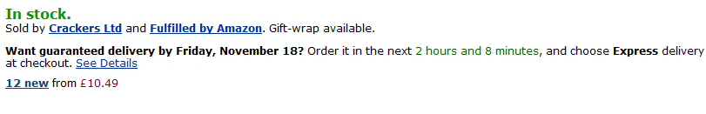
Planning for the rush
Is your inventory fully up to date?
Are you ready to take orders from multiple channels?
Are you using FBA to increase your fulfilment capacity and offer a better shopping experience?

Slide 12
Agenda
  Analysing your sales with the Business Reports
  Getting your products discovered
  Planning for the rush
  Keeping customers in mind
  Summary
  Q&A
  Useful References

Slide 13


Keeping Customers in Mind
Provide a reliable shipping service
Amazon customers expect the best service possible,
especially for Christmas. Please do not disappoint them!
Ship on time. Put your account on holidays if you think you won’t be able to fulfill orders and/or adapt your handling time to ship:
Provide Tracking Numbers when you confirm shipments:

Slide 14
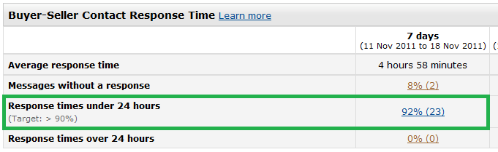
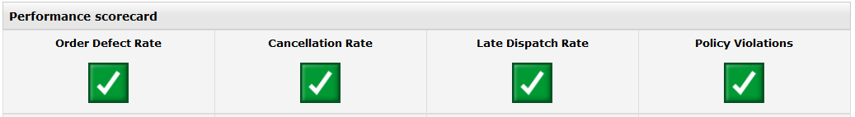
Keeping Customers in Mind
Don’t forget about customer service
Don’t forget that your job as a seller does not stop after shipping the orders.
Respond to Buyers in a timely and professional manner :
Monitor your Performance Metrics: Address feedbacks, returns and refunds requests promptly, this will prevent A-Z Claims.

Slide 15
Agenda
  Analysing your sales with the Business Reports
  Getting your products discovered
  Planning for the rush
  Keeping customers in mind
  Summary
  Q&A
  Useful References

Slide 16
Summary
Monitor your sales to stock up on best selling items and identify slow-moving items
Increase the visibility of slow-moving items by providing better product descriptions and putting the items in the correct Amazon browse node.
Plan ahead: have an accurate inventory on sale, make use of Amazon features to diversify your sales and facilitate order fulfilment.
Have reliable shipping methods not to disappoint buyers with late, lost or cancelled orders.
Be customer friendly at all times and be ready to receive returns and refunds requests.
Monitor your performance and avoid potential claims or suspensions.

Slide 17
Q & A

Slide 18
Useful References
Sales Success Using Business Reports
Fix Listings with Missing Information
Browse Tree Guides
Confirm Shipments
Getting Good Feedback with Customer Service
Seller Performance Measurement
Festive Season Best Practices
Increasing Sales Tips
Webinar Recordings

Slide 19
Thank you!
http://services.amazon.co.uk/resources/events-webinars/

