Slide 1

Getting off to a good start after Christmas
Part 1: Dealing with Customers
Confidential © 1996-2011, Amazon.com, Inc. or its affiliates. All rights reserved.

Slide 2
Agenda
  Buyer-Seller Messaging
  Customer Returns and Refunds
  Why Customer Service Matters
  Q&A
  Useful References

Slide 3
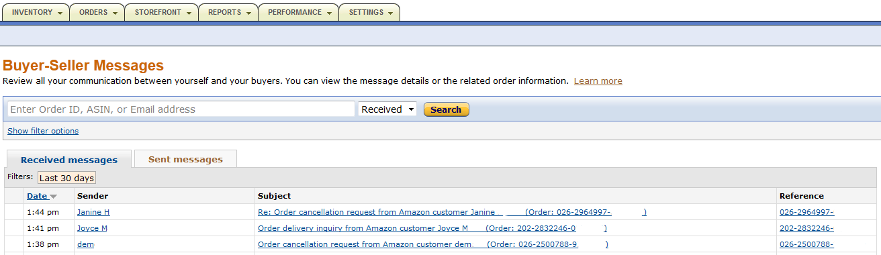
Dealing with Customers
Buyer-Seller Messaging
You are likely to receive contacts from buyers regarding their Christmas orders.
Please check your Buyer-Seller Messages in your Seller Central account.
Click ‘Messages’ at the top right, or in the new widget located in the right-side menu bar of your Seller Central homepage

Slide 4
Dealing with Customers
Buyer-Seller Messaging
The Buyer-Seller Messaging Service:
Allows you to receive and send messages to Amazon buyers, directly within Seller Central, or via your own email system
Uses encrypted email addresses (ex: 91234b@marketplace.amazon.co.uk) to ensure greater privacy and security
Facilitates faster and better resolution of disputes by allowing Amazon investigators to review communications before accepting an A-Z claim
When emailing buyers you should not:
Include links to any/your website
Include promotional or marketing messages
Refer the buyer to other products or promotions

Slide 5
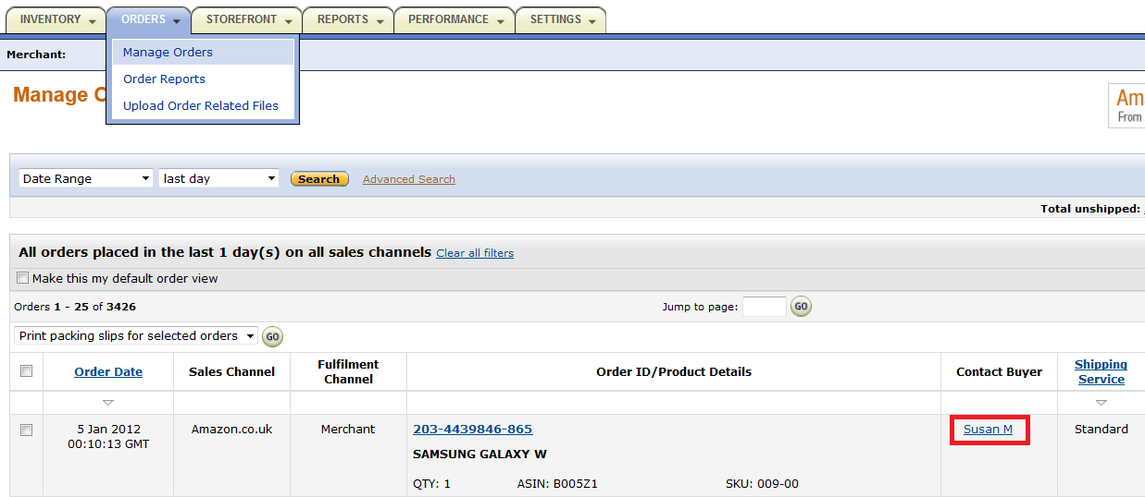
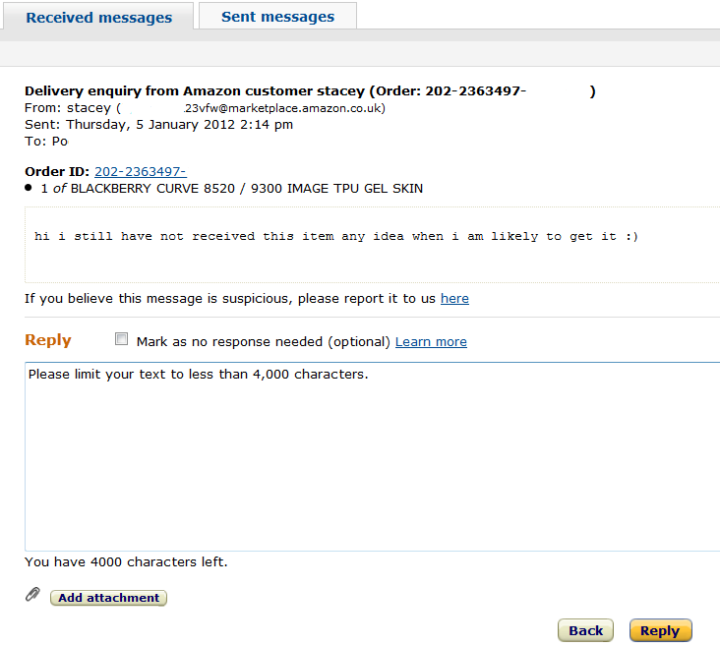
Dealing with Customers
Buyer-Seller Messaging
How to proactively contact a buyer:
Go to ‘Manage Orders’
Click on the name of the buyer in the ‘Contact Buyer’ column:
How to respond to a buyer:
Click on the buyer’s email in ‘Received Messages’ in the Buyer-Seller Messaging Service and write your reply:

Slide 6
Agenda
  Buyer-Seller Messaging
  Customer Returns and Refunds
  Why Customer Service Matters
  Q&A
  Useful References

Slide 7
Dealing with Customers
Customer Returns and Refunds
You are likely to process returns and refunds requests from buyers because:
The item arrived damaged
The package was lost or arrived too late
The buyer no longer wants the item
-> You should make sure to respect the Marketplace Returns and Refunds policies to provide a good customer experience.
-> You need to make sure you respect applicable laws and regulations.

Slide 8
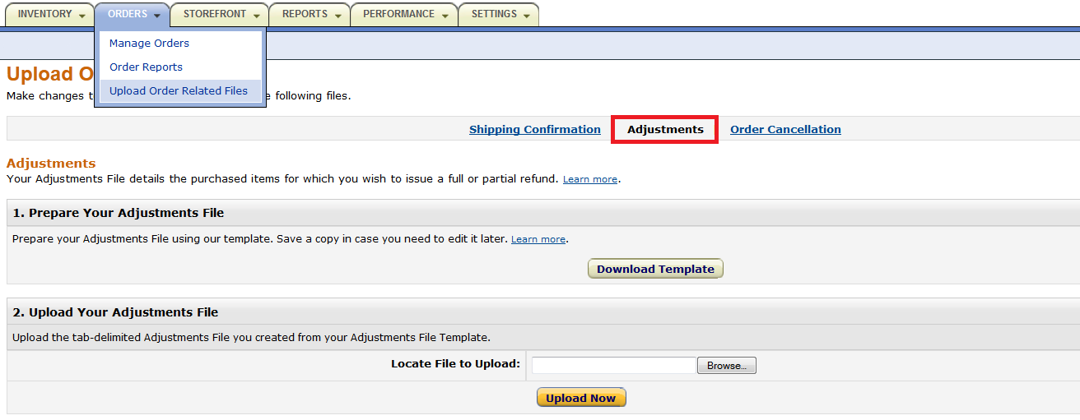
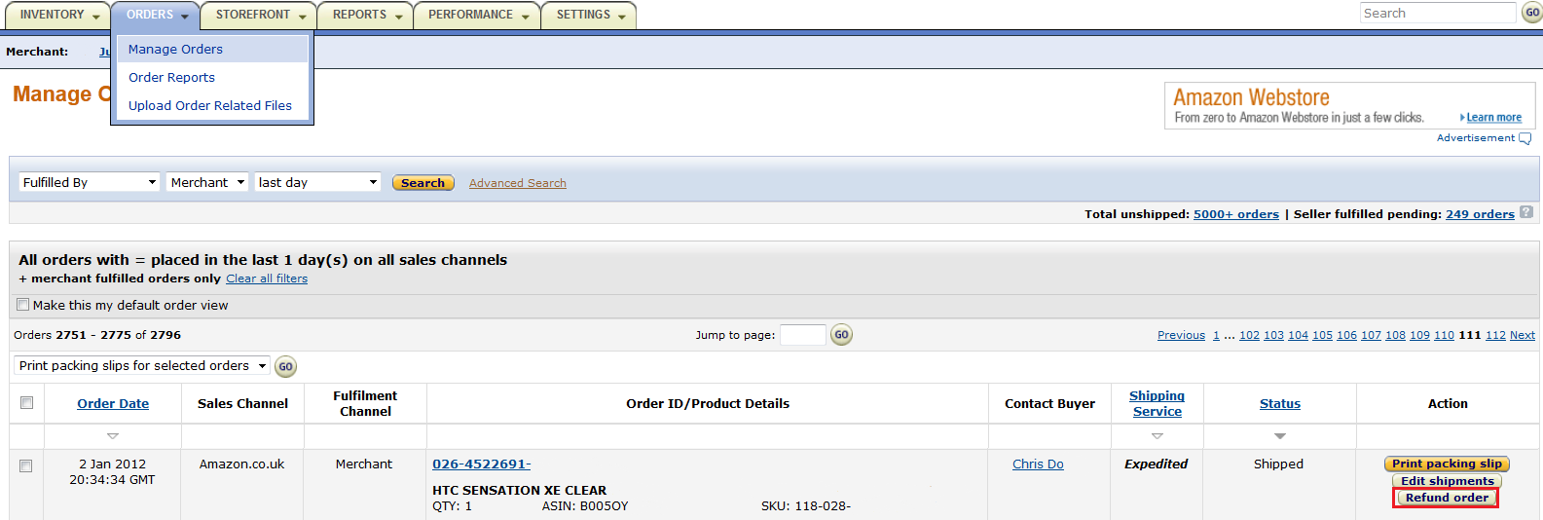
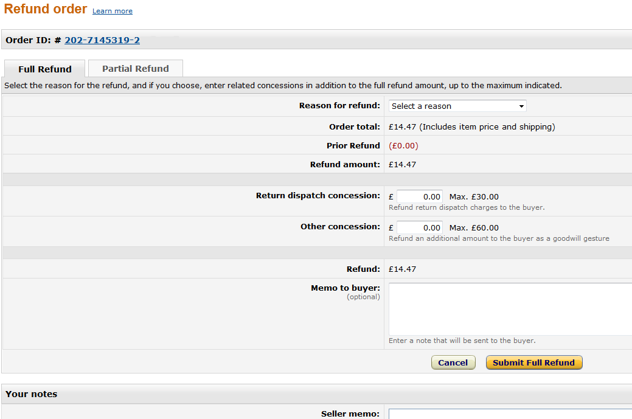
Dealing with Customers
Customer Returns and Refunds
You can issue refunds in 2 ways:
For each individual order in ‘Manage Orders’ and ‘Refund Order’
For several orders at once by uploading a file in ‘Upload Order Related Files’

Slide 9

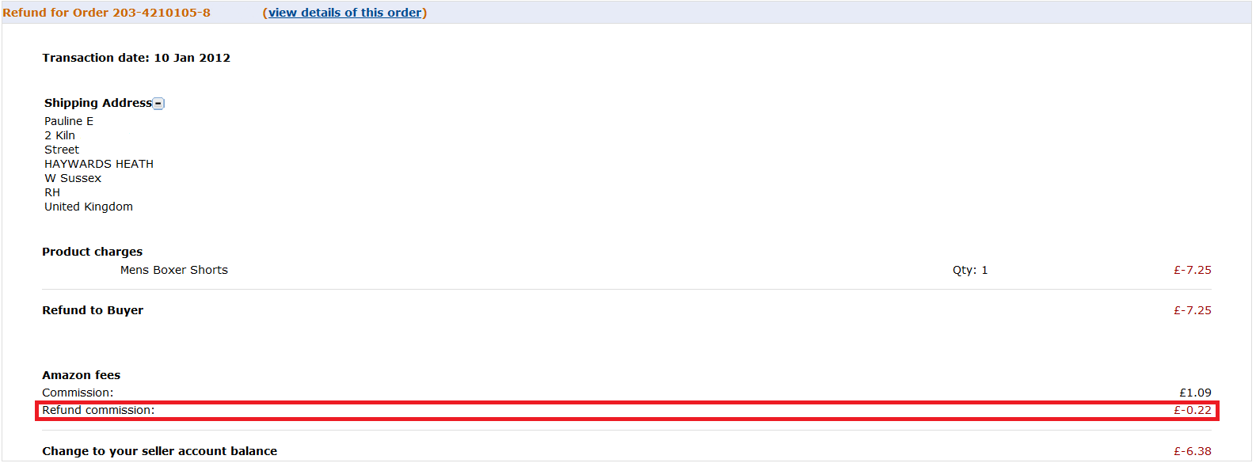
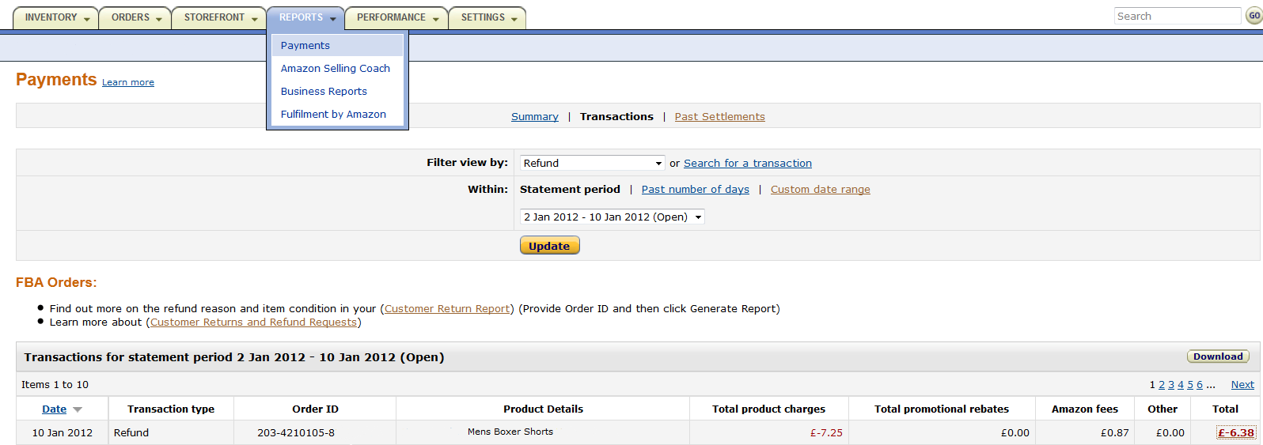
Dealing with Customers
Customer Returns and Refunds
Please note:
You can only refund if the order was confirmed as shipped
A refund cannot be undone
For non-media items, Amazon will retain 20% of the original sales commission (up to 5GBP) when crediting your account

Slide 10
Agenda
  Buyer-Seller Messaging
  Customer Returns and Refunds
  Why Customer Service Matters
  Q&A
  Useful References

Slide 11
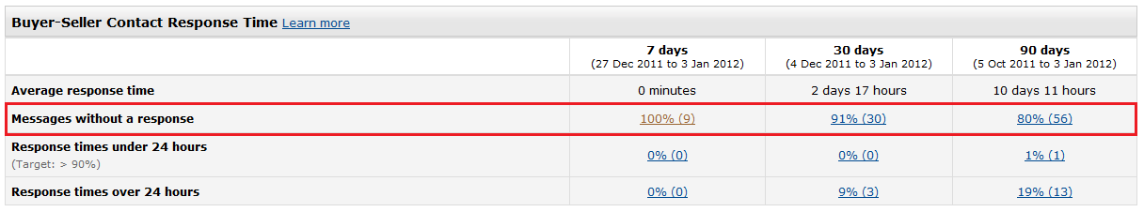

Dealing with Customers
Why Customer Service Matters
Amazon sellers should aim to provide the best possible customer service.
Respond to Buyers in a timely (ie. Within 24 hours) and professional manner :
Check your Feedbacks and address negative comments proactively.

Slide 12
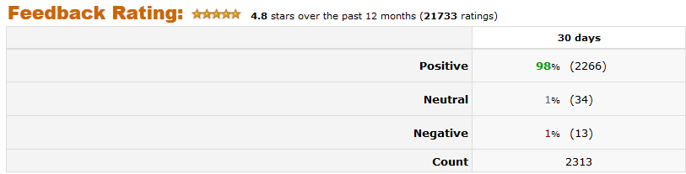

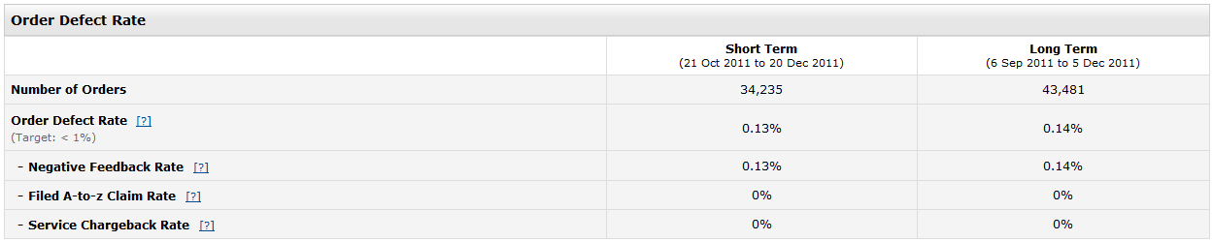
Dealing with Customers
Why Customer Service Matters
Inexistent, slow or unprofessional service will make your buyers unhappy, which will:
Affect your feedback rating, which could have an impact on your future sales
Affect your customer metrics by increasing your Order Defect Rate (‘ODR’). A high ODR can lead to your account’s suspension or termination.

Slide 13
Q & A

Slide 14
Useful References
Getting Good Feedback with Customer Service – Video Tutorial
Buyer-Seller Messaging Service
Marketplace Returns and Refunds – Information for buyers
Marketplace Returns and Refunds – Information for sellers
Refund Orders
Issue Multiple Refunds at Once
Seller Performance Measurement
Webinar Invitations and Recordings
Visit our Help Pages or Contact Seller Support for More Information

Slide 15
Thank you!
http://services.amazon.co.uk/resources/events-webinars/

