Slide 1

Getting off to a good start after Christmas
Part 2: Clearing up Your Stock with Promotions

Slide 2
Agenda
  Identify Overstock
  Setting Up a Sale Price
  Setting Up a Promotion
  Q&A
  Useful References

Slide 3
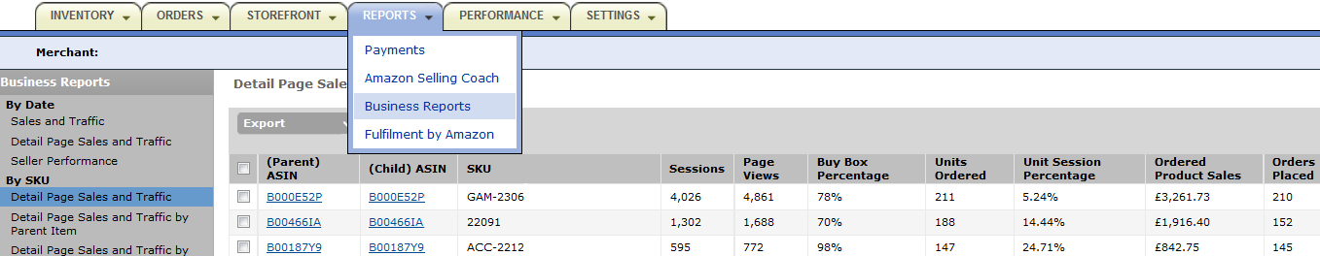
Clearing Up Your Stock with Promotions
Identify Overstock
You should identify stock that did not sell as well as you expected.
For example:
The ‘Detail Page Sales and Traffic’ Business Report shows your best-selling and least popular items:
You can see how many people looked at your products
And your sales conversion, so how many units you sold compared to the number of sessions
Notes:
Vous restez le propriétaire de votre stock et le vendeur officiel tandis qu’Amazon assure l’intendance.
Vous disposez d’un accès en temps réel aux informations et aux rapports sur votre stock via notre outil Web.
Vous gardez la maîtrise de tous les aspects liés à la vente : gestion des offres, description et tarification des produits.

Slide 4
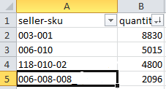

Clearing Up Your Stock with Promotions
Identify Overstock
You can then compare the units sold with your current quantity in stock:
Export the Detail Page Sales and Traffic report, for example for a 1 month period
Download an Inventory File from the Inventory tab, listing your products’ quantities in stock
Identify items which have large quantities in stock but relatively low sales
If you sold 91 units in one month and have 2,096 units in stock, you have 23 months of cover before you run out of stock.
You should find ways to sell through your stock more quickly.
Notes:
Vous restez le propriétaire de votre stock et le vendeur officiel tandis qu’Amazon assure l’intendance.
Vous disposez d’un accès en temps réel aux informations et aux rapports sur votre stock via notre outil Web.
Vous gardez la maîtrise de tous les aspects liés à la vente : gestion des offres, description et tarification des produits.

Slide 5
Agenda
  Identify Overstock
  Setting Up a Sale Price
  Setting Up a Promotion
  Q&A
  Useful References

Slide 6
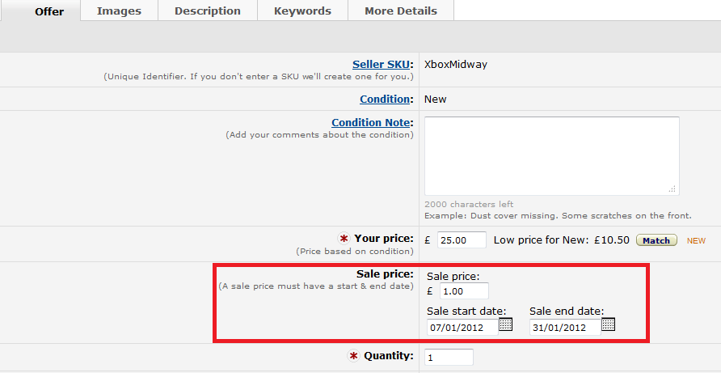
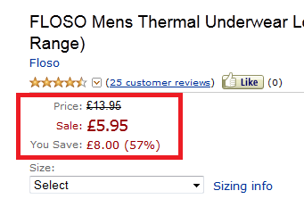
Clearing Up Your Stock with Promotions
Setting up a Sale Price
The quickest way to put an item on sale is to set up a sale price:
Go to your Inventory, then click ‘Edit Details’ for your chosen item
Set your Sale Price with a Start and End Sales Date, click ‘Save and Finish’
Your standard price and your new sales price will be displayed to buyers if you have the Buy Box:
Notes:
Vous restez le propriétaire de votre stock et le vendeur officiel tandis qu’Amazon assure l’intendance.
Vous disposez d’un accès en temps réel aux informations et aux rapports sur votre stock via notre outil Web.
Vous gardez la maîtrise de tous les aspects liés à la vente : gestion des offres, description et tarification des produits.

Slide 7
Agenda
  Identify Overstock
  Setting Up a Sale Price
  Setting Up a Promotion
  Q&A
  Useful References

Slide 8
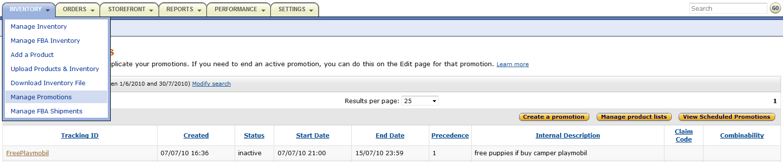
Clearing Up Your Stock with Promotions
Setting up a Promotion
You can set up promotions by going in ‘Manage Promotions’ in the Inventory tab:
Go to ‘Manage Product Lists’ and ‘Create a New Product Selection’, to list products for which the promotion will apply (optional).
Go to ‘Create a Promotion’ and go through 5 steps:
Choose a Promotion Type
Create Benefits and Qualifications
Input Tracking Info
Create Messaging
Review Promotion
Notes:
Vous restez le propriétaire de votre stock et le vendeur officiel tandis qu’Amazon assure l’intendance.
Vous disposez d’un accès en temps réel aux informations et aux rapports sur votre stock via notre outil Web.
Vous gardez la maîtrise de tous les aspects liés à la vente : gestion des offres, description et tarification des produits.

Slide 9
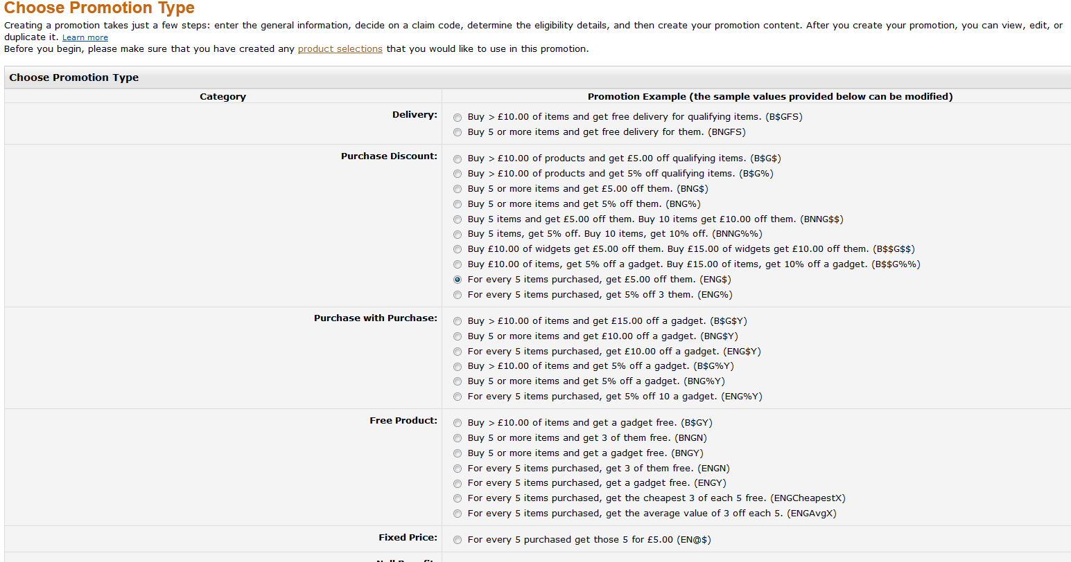
Clearing Up Your Stock with Promotions
Setting up a Promotion – Step 1
Promotion Type: select what kind of promotion you want to offer.
Please note: Promotions are not possible for all products (ie. Not for BMVD).

Slide 10
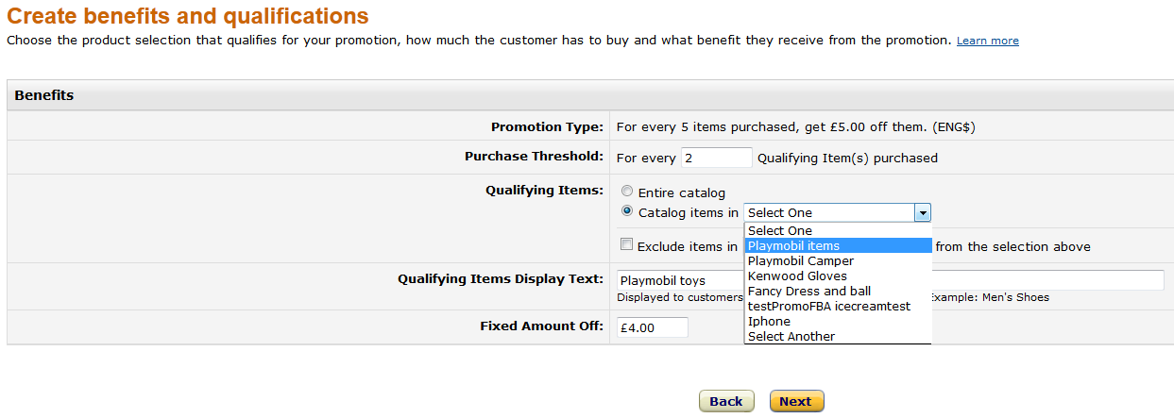
Clearing Up Your Stock with Promotions
Setting up a Promotion – Step 2
Benefits: customize the promotion type by clarifying what you will offer, such as the amount of the discount.
Qualifications: this is where you can select the product list you previously created.

Slide 11
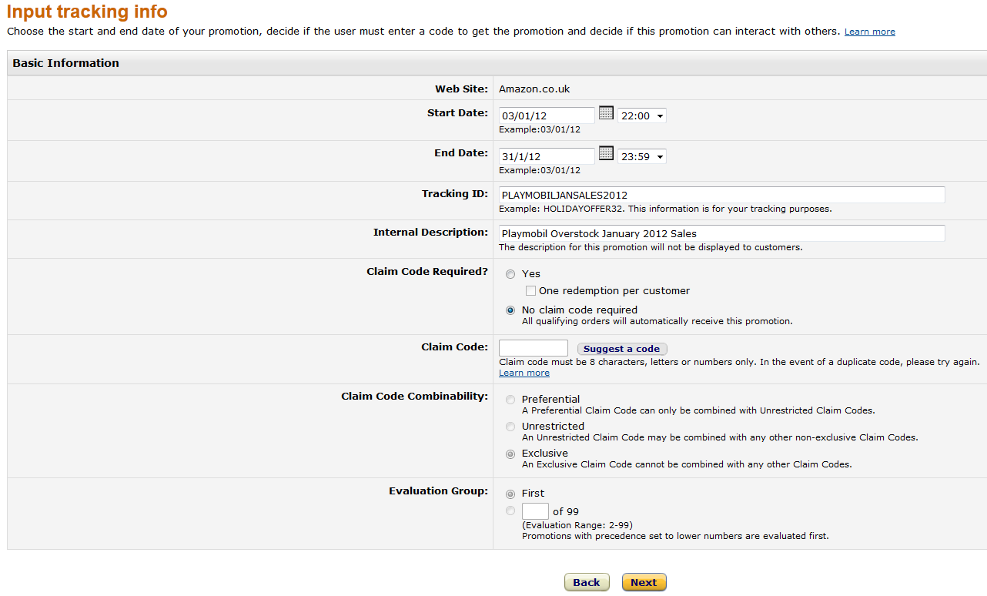
Clearing Up Your Stock with Promotions
Setting up a Promotion – Step 3
Tracking Info: name and select dates for your promotion. Claim codes are optional.

Slide 12
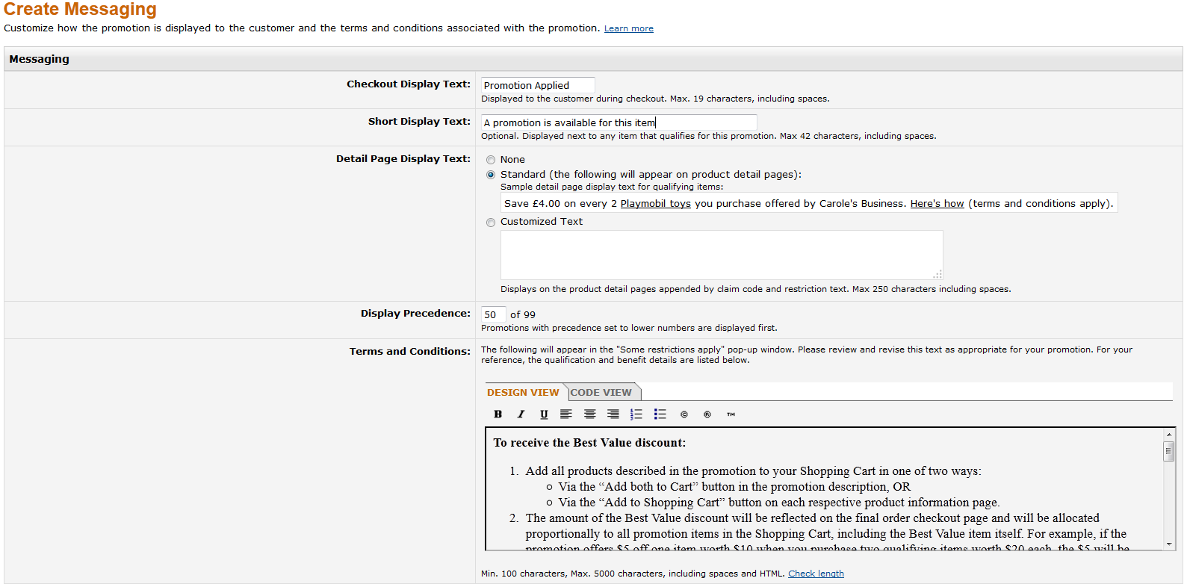
Clearing Up Your Stock with Promotions
Setting up a Promotion – Step 4
Messaging: you can personalize the text that will be displayed to buyers, or use standard templates.

Slide 13
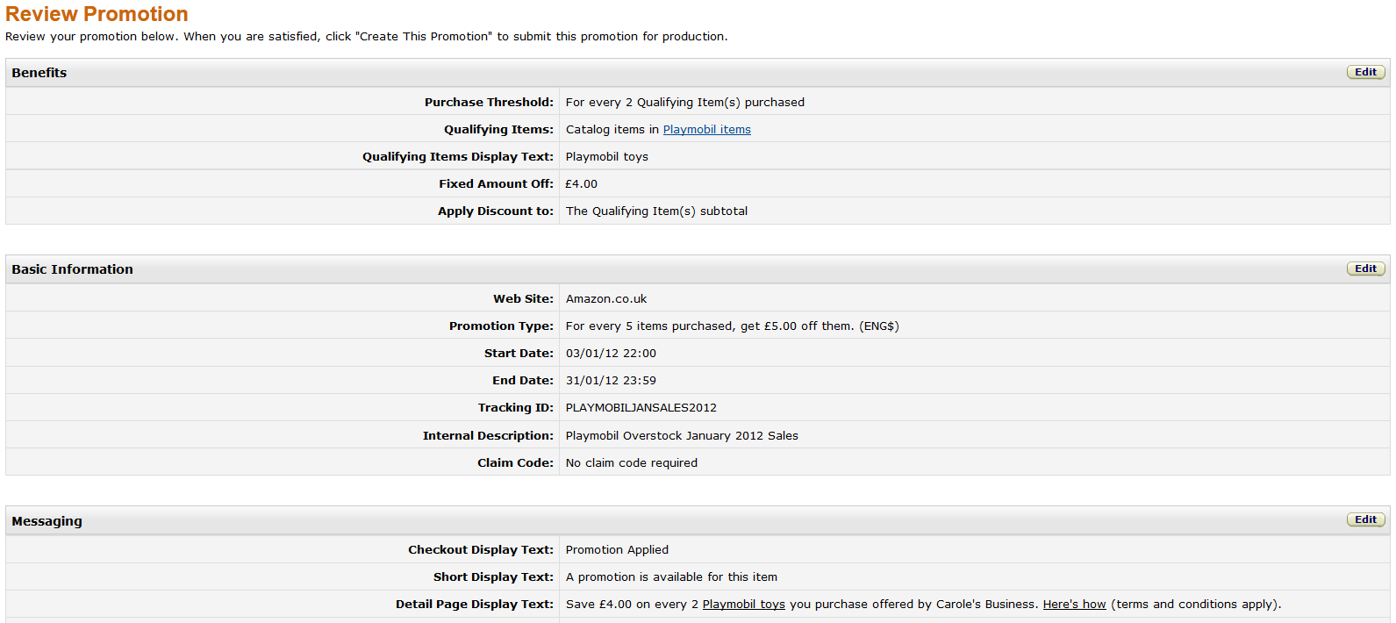

Clearing Up Your Stock with Promotions
Setting up a Promotion – Step 5
Review: check and if necessary edit the details of the promotion before creating it.

Slide 14
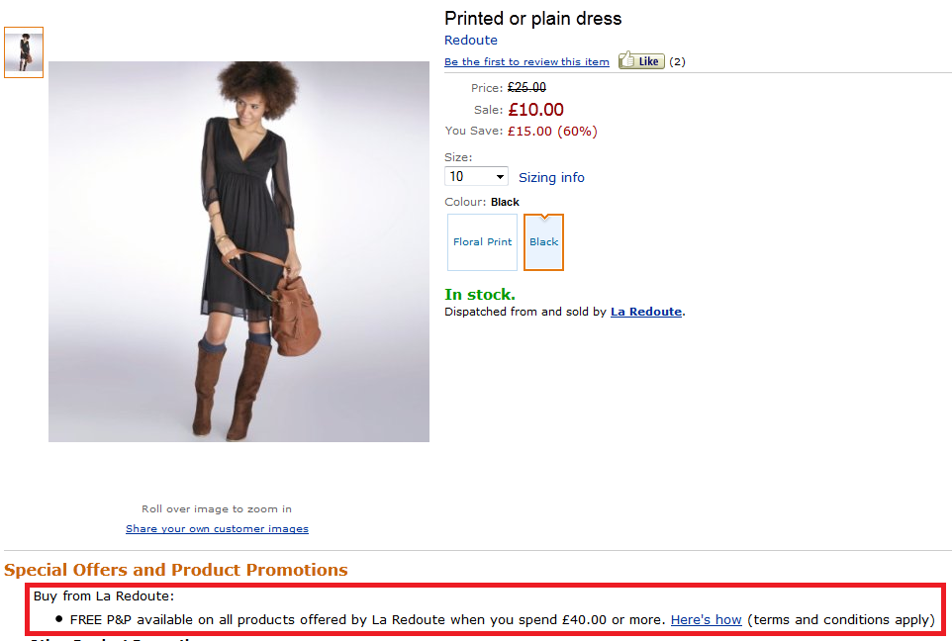
Clearing Up Your Stock with Promotions
How Promotions Appear to Buyers
The display text you selected will appear below the product’s image:

Slide 15
Q & A

Slide 16
Useful References
Sales Success Using Business Reports
Overview of Promotions
Promotions Help Page
Webinar Invitations and Recordings
Visit our Help Pages or Contact Seller Support for More Information

Slide 17
Thank you!
http://services.amazon.co.uk/resources/events-webinars/

