Slide 1

Getting off to a good start after Christmas
Part 3: Fulfilment by Amazon

Slide 2
Agenda
  Overview of FBA Reports
  Sales Reports
  Customer Returns Report
  Inventory Health Report
  Long Term Storage Program
  Other News
  Q&A
  Useful References

Slide 3
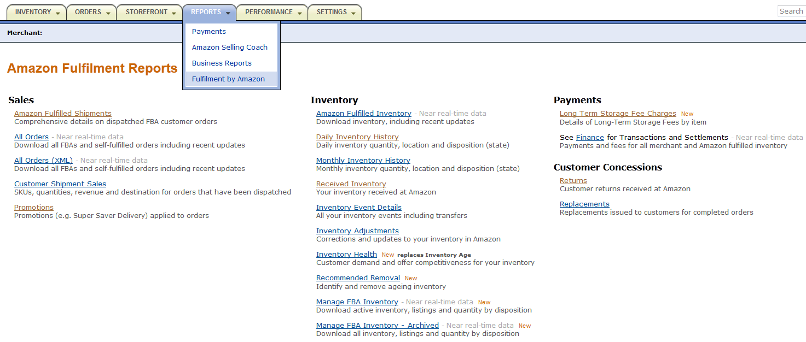
Fulfilment by Amazon
Overview of FBA Reports
FBA reports give you all necessary information regarding your FBA business:
You must provide invoices to your buyers if they request it.
Amazon does not include invoices in FBA shipments.
Buyers’ details for invoicing are available in the shipment report.
Check your best sellers, your overstock and your aging inventory.
Amazon handles customer returns, but you can see them in this report, including the reasons given by the buyers.

Slide 4
Agenda
  Overview of FBA Reports
  Sales Reports
  Customer Returns Report
  Inventory Health Report
  Long Term Storage Program
  Other News
  Q&A
  Useful References

Slide 5
Fulfilment by Amazon
FBA Sales Reports
The Amazon Fulfilled Shipments report is available once a day and is useful for:
Customer contact and invoicing (email and billing address columns)
Tracking multi-channel orders (Carrier and tracking-number columns)
UK sellers should be aware that German buyers are especially keen on receiving invoices
The All orders report shows all FBA and merchant fulfilled orders. It is near real-time and is useful for:
Better inventory synchronisation: you can see pending orders, so you do not oversell on your other sales channels.
Sales performance analysis. Ex: you can compare sales by fulfilment channel, sales channel, country, SKU, etc…

Slide 6
Agenda
  Overview of FBA Reports
  Sales Reports
  Customer Returns Report
  Inventory Health Report
  Long Term Storage Program
  Other News
  Q&A
  Useful References

Slide 7
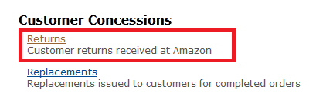
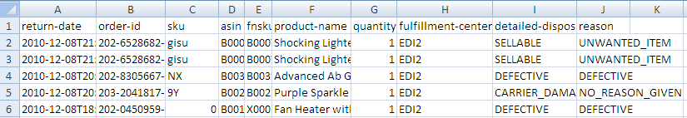
Customer Returns Report
Fulfilment by Amazon
We know that there are often customer returns after Christmas. You can check those in the Customer Returns report. This could give you clues about problematic items in your FBA stock:
If the item is sellable, it is put back for sale in your stock
If it has been damaged by Amazon or its carrier, we refund both you and the buyer and will remove the unit from your stock
If it has been damaged by the buyer, or is defective, it is put back in your stock as ‘unfulfillable’
FBA fees are not refundable
See FBA Manual 7.5 for details

Slide 8
Agenda
  Overview of FBA Reports
  Sales Reports
  Customer Returns Report
  Inventory Health Report
  Long Term Storage Program
  Other News
  Q&A
  Useful References

Slide 9
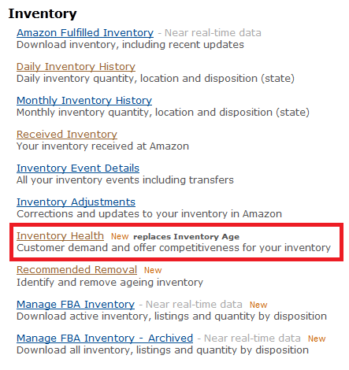
Fulfilment by Amazon
FBA Inventory Health Report
You should regularly monitor your FBA stock performance to:
Increase your sales
Minimise your storage costs
    The report gives you detailed data about your FBA stock:
    Current Sellable and Unsellable Quantities
    Inventory Age
    Units Shipped to Buyers
    Weeks of Cover
    Number of Competing Offers
    Lowest Prices Information (inclusive of shipping charges)
    Expected Long Term Storage Units and Fees

Slide 10
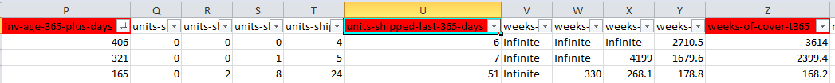
Fulfilment by Amazon
FBA Inventory Health Report – Usage Examples
Identify the oldest stock in FBA Storage:
Filter those columns to
see slow-moving or ‘dead’ stock
It is not advisable to replenish dead stock.
Check if it is selling at all, and if so, check what your weeks of cover are :
At this current sales pace, you
have enough stock to last about
70 years…Is that really what you want?

Slide 11

Fulfilment by Amazon
FBA Inventory Health Report – Usage Examples
Check if you can do anything to get the stock to sell
If you already are the cheapest, and have done
everything you could without success (ex: improving
product description), then consider removing that stock
Also identify ‘healthy’ stock, that is: recently added, in adequate quantities, and which is selling at a good pace:
Make sure you replenish if newly added
stock sells faster than you expected!

Slide 12
Agenda
  Overview of FBA Reports
  Sales Reports
  Customer Returns Report
  Inventory Health Report
  Long Term Storage Program
  Other News
  Q&A
  Useful References

Slide 13
Fulfilment by Amazon
Long Term Storage Program
On 15th February, the next long term storage fees will be applied to units which have been stored in FBA for one year or longer.
You can see what long term fees you were charged, for which units, at the last review
You can see which units will be affected by the next review in the inventory health report
If you wish, you can create a removal order for the affected units from here

Slide 14

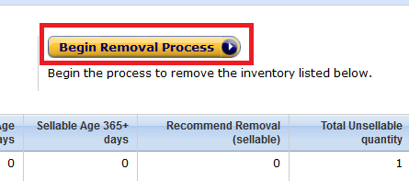
Fulfilment by Amazon
Long Term Storage Program
The Inventory Health Report shows units that will be affected by the next review
The number of sellable Units that will have been in storage for 365+ days as of the next Inventory Cleanup (15 August or 15 February)
The projected Long-Term Storage Fees that will be charged for the Est. Long-Term Storage Units (assuming no further sales of your inventory)
If you decide to remove the affected units, you can use the Recommended Removal report to create a removal order:

Slide 15
Fulfilment by Amazon
Long Term Storage Program
Please note the following regarding the Long-Term Storage Fee:
With effect from 15 February 2012, the fee structure will change from an annual fee of £1,765 per cubic metre (£50 per cubic foot) to a semi-annual fee of £882.50 per cubic metre (£25 per cubic foot).
Units that were charged a Long-Term Storage Fee on 15 August 2011 will not be charged a Long-Term Storage Fee on 15 February 2012.
February 2012 August 2012 February 2013 August 2013
Annual charge of £50/cubic foot, paid in February 2012 and running to February 2013.
Semi-annual charge of £25/cubic foot, paid in February 2012, running to August 2012.

Slide 16
Agenda
  Overview of FBA Reports
  Sales Reports
  Customer Returns Report
  Inventory Health Report
  Long Term Storage Program
  Other News
  Q&A
  Useful References

Slide 17
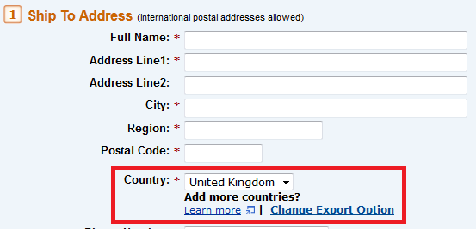
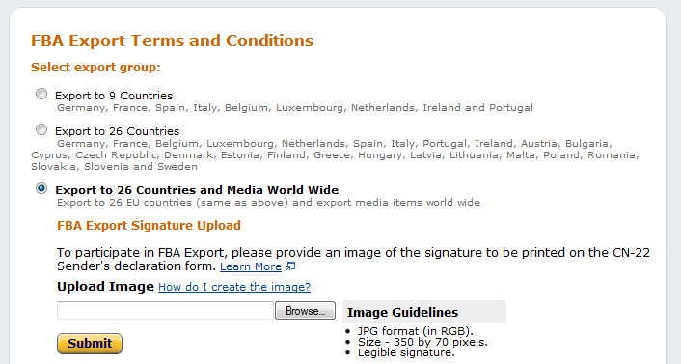
Fulfilment by Amazon
Other News
Export for Multi-Channel Fulfilment now available in the EU:
Media products can now be exported worldwide:
Reminder: FBA UK Fees will change on 1st March. Check them here.

Slide 18
Q & A

Slide 19
Useful References
FBA Reports
FBA Pricing
Creating FBA Removals
FAQ about the FBA Long Term Storage Program
Webinar Invitations and Recordings
Visit our Help Pages or Contact Seller Support for More Information

Slide 20
Thank you!
http://services.amazon.co.uk/resources/events-webinars/

