Slide 1


Slide 2
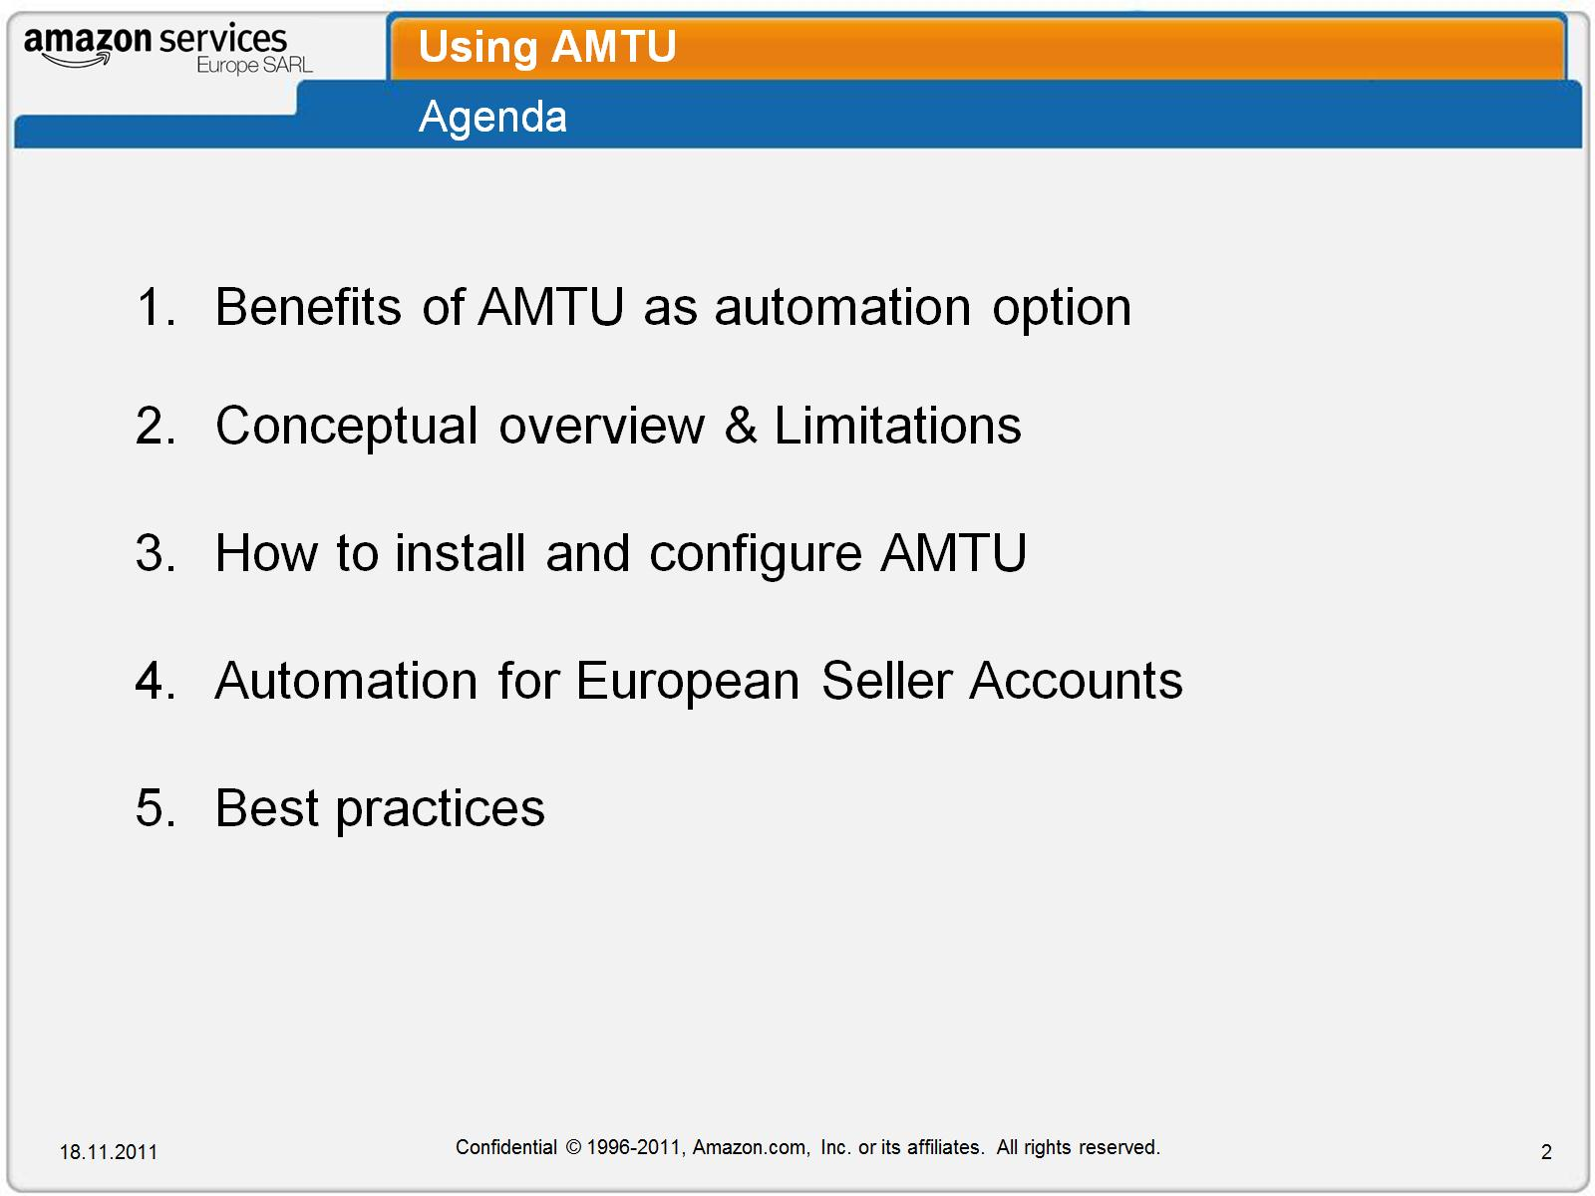
Using AMTU

Slide 3
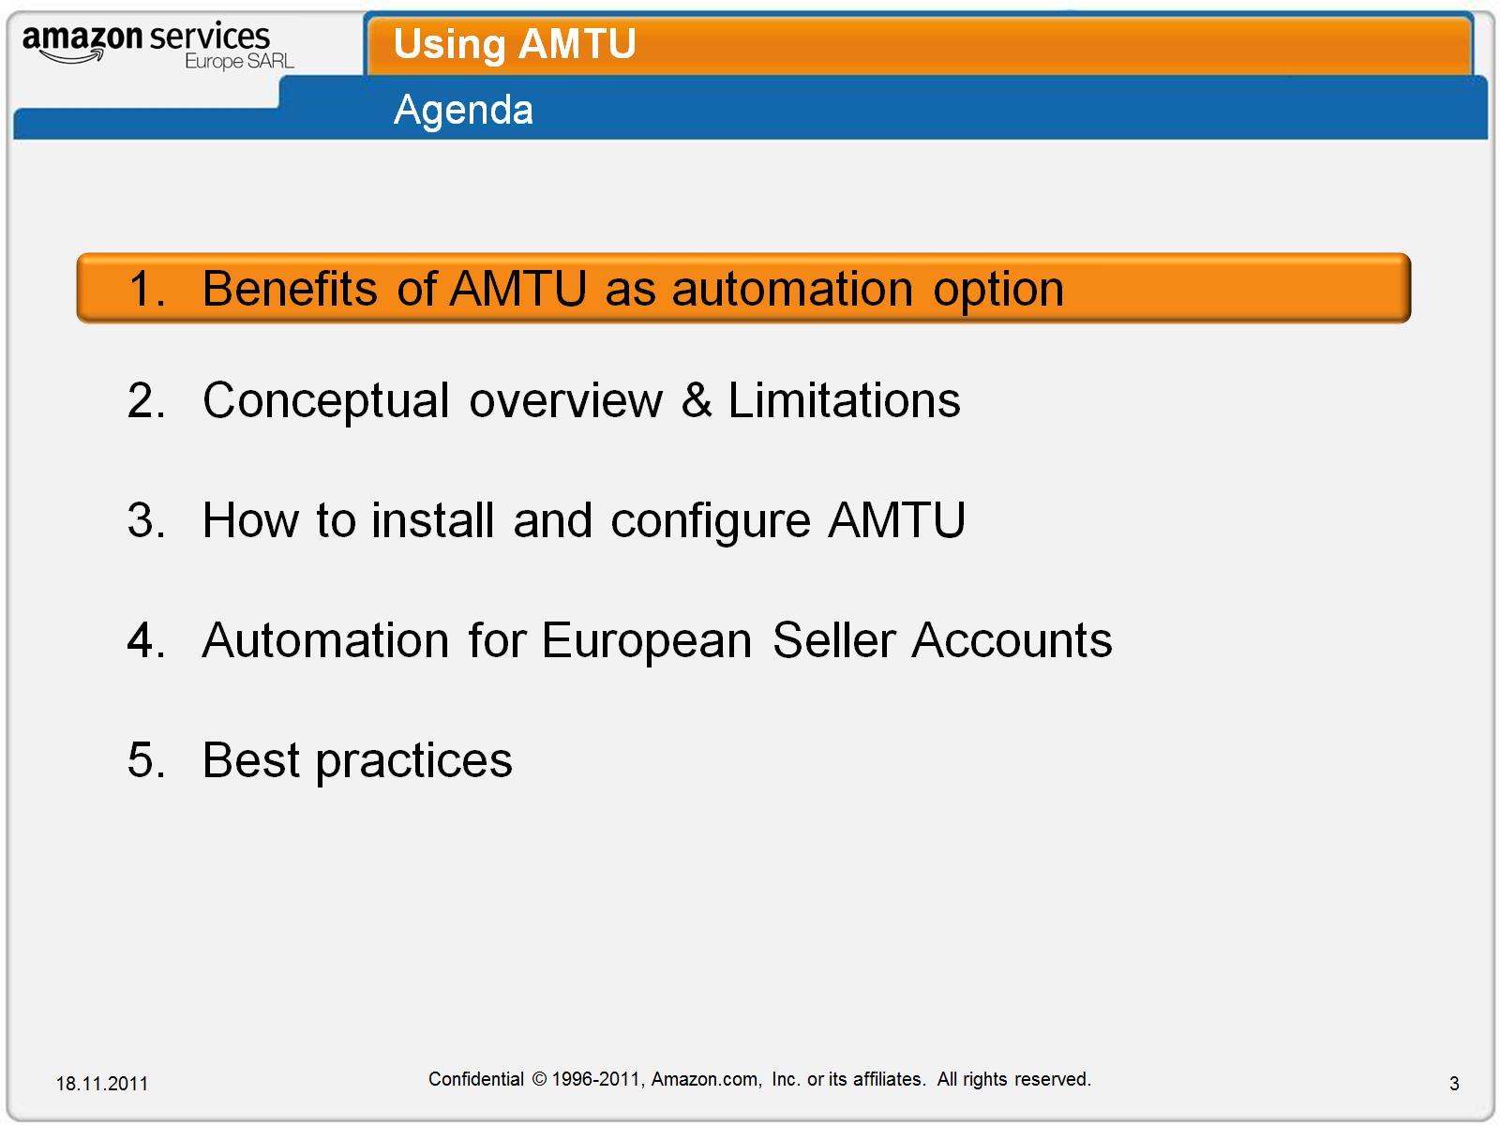
Using AMTU

Slide 4
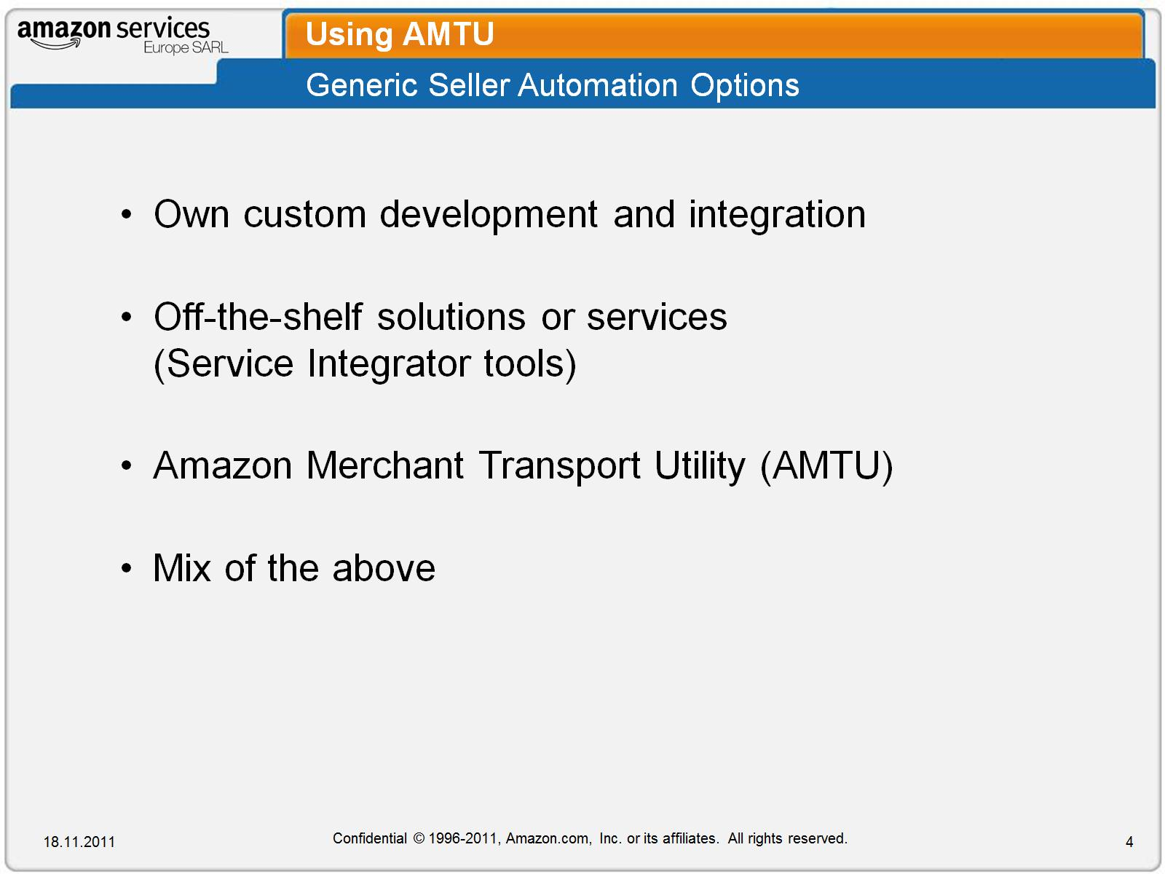
Using AMTU

Slide 5
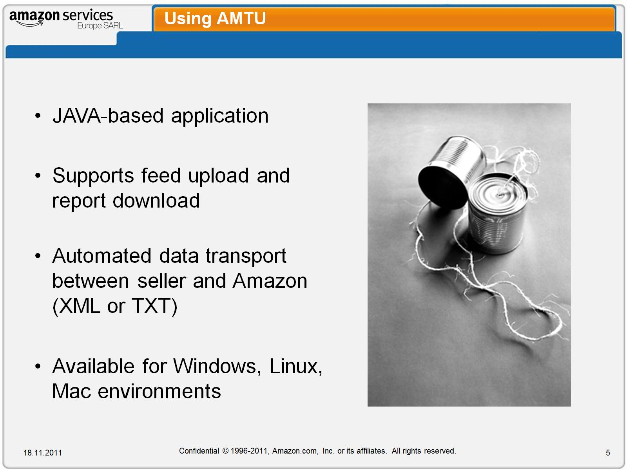
Using AMTU

Slide 6
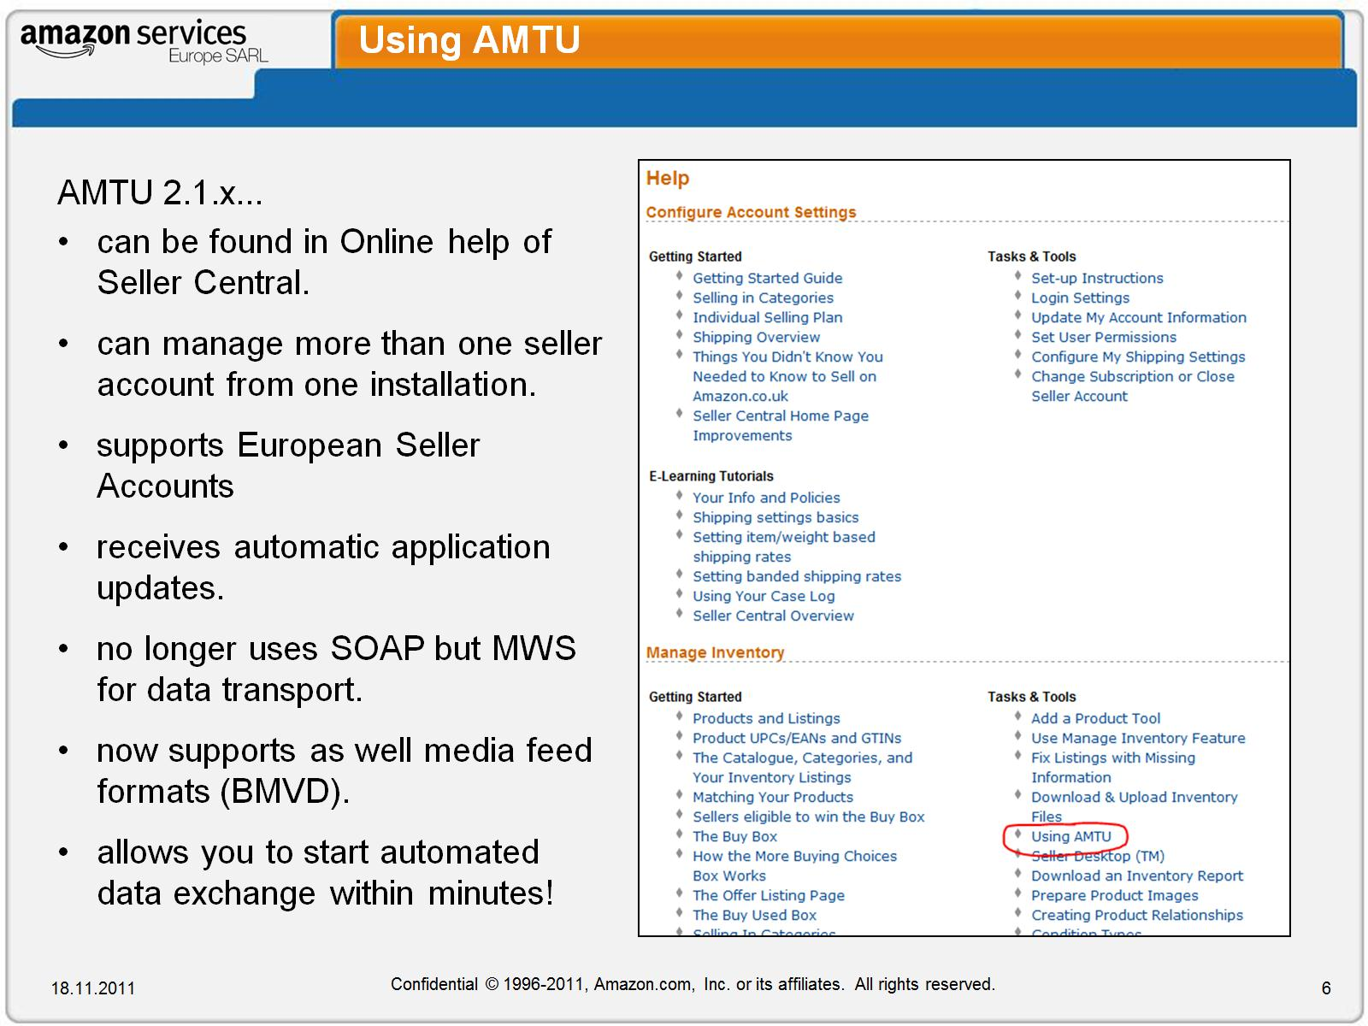
Using AMTU

Slide 7
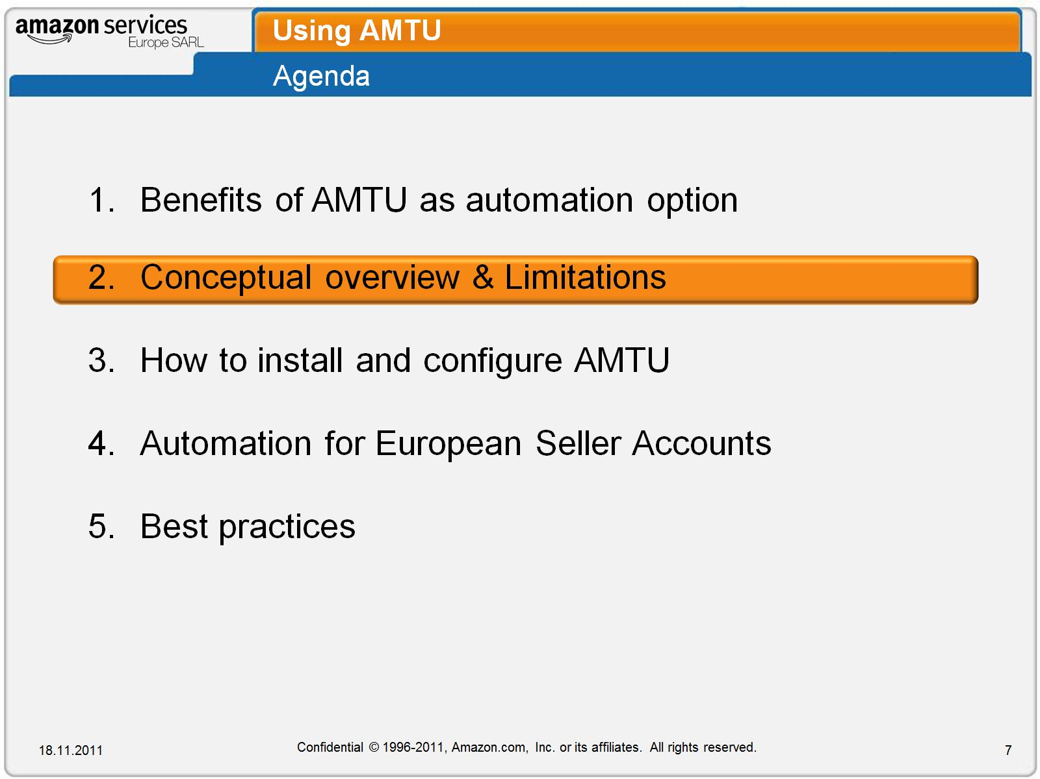
Using AMTU

Slide 8
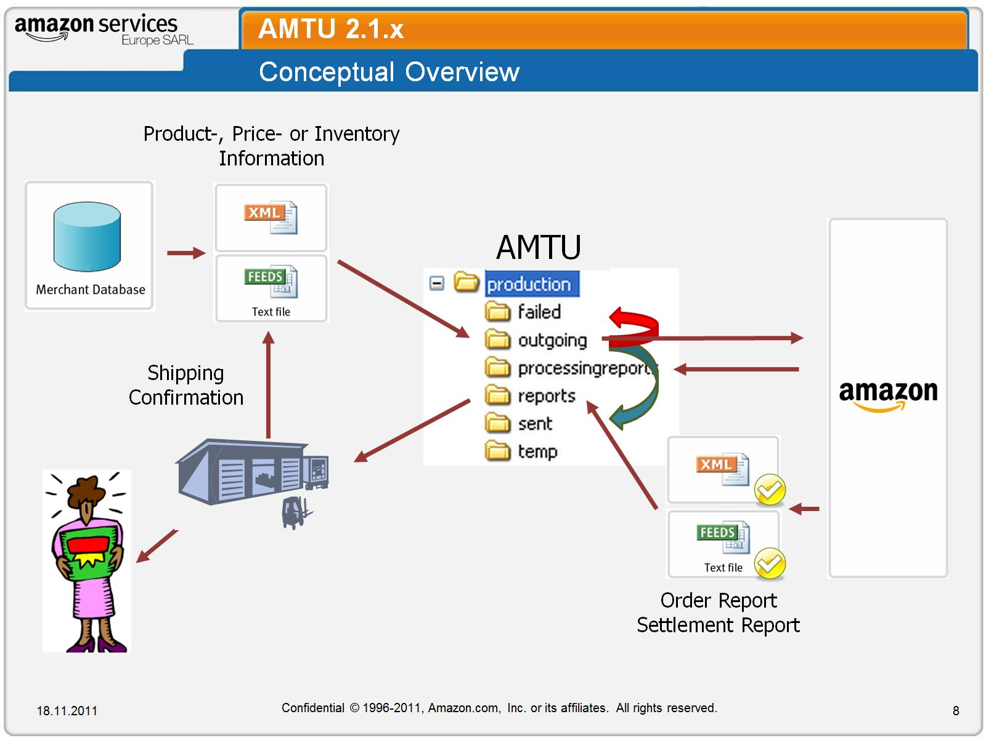
AMTU 2.1.x

Slide 9
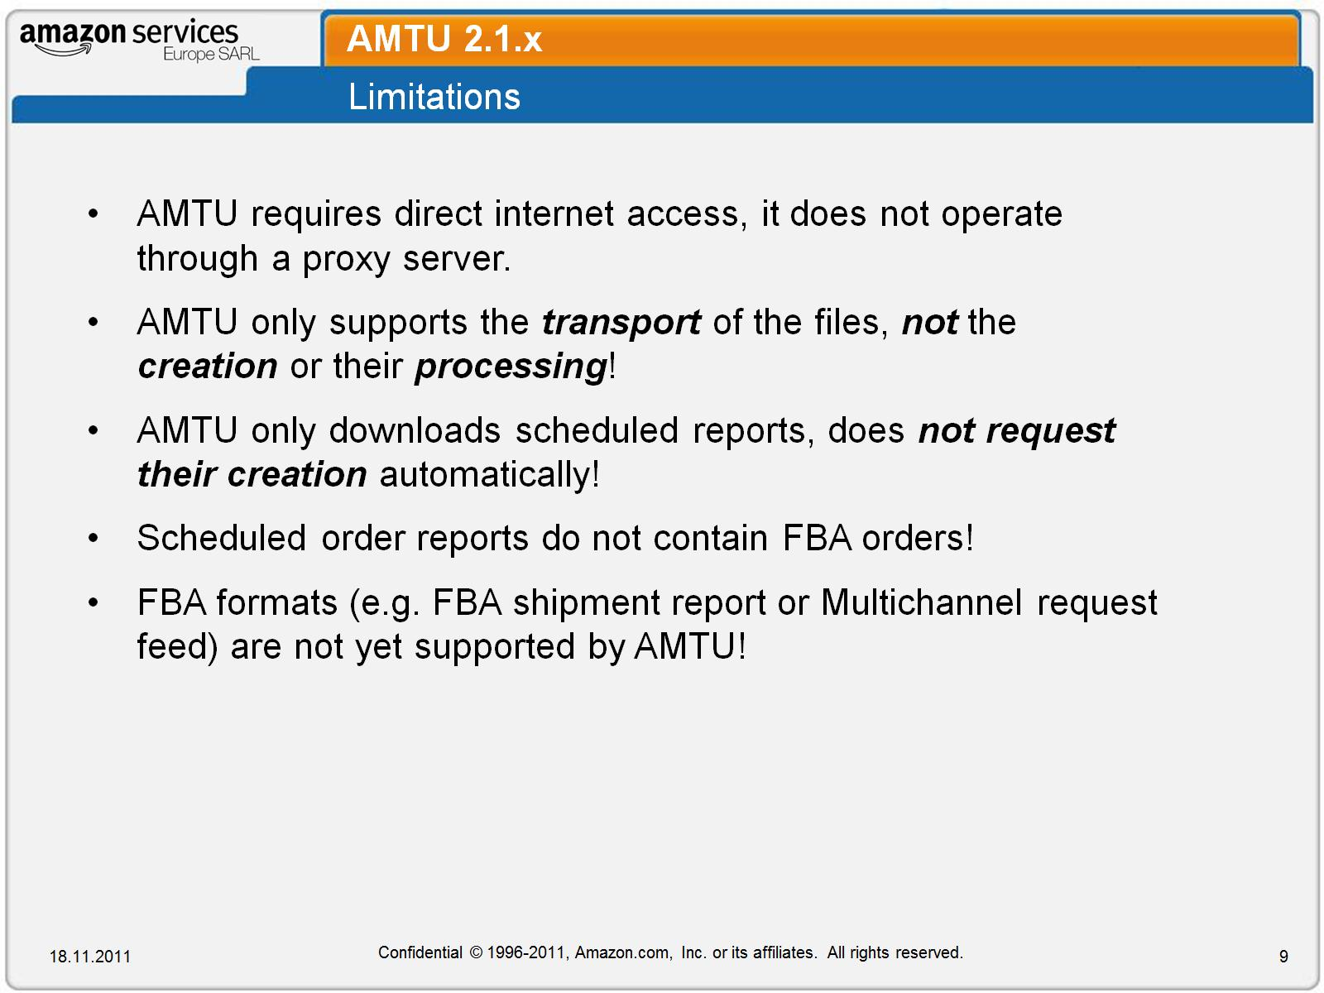
AMTU 2.1.x

Slide 10
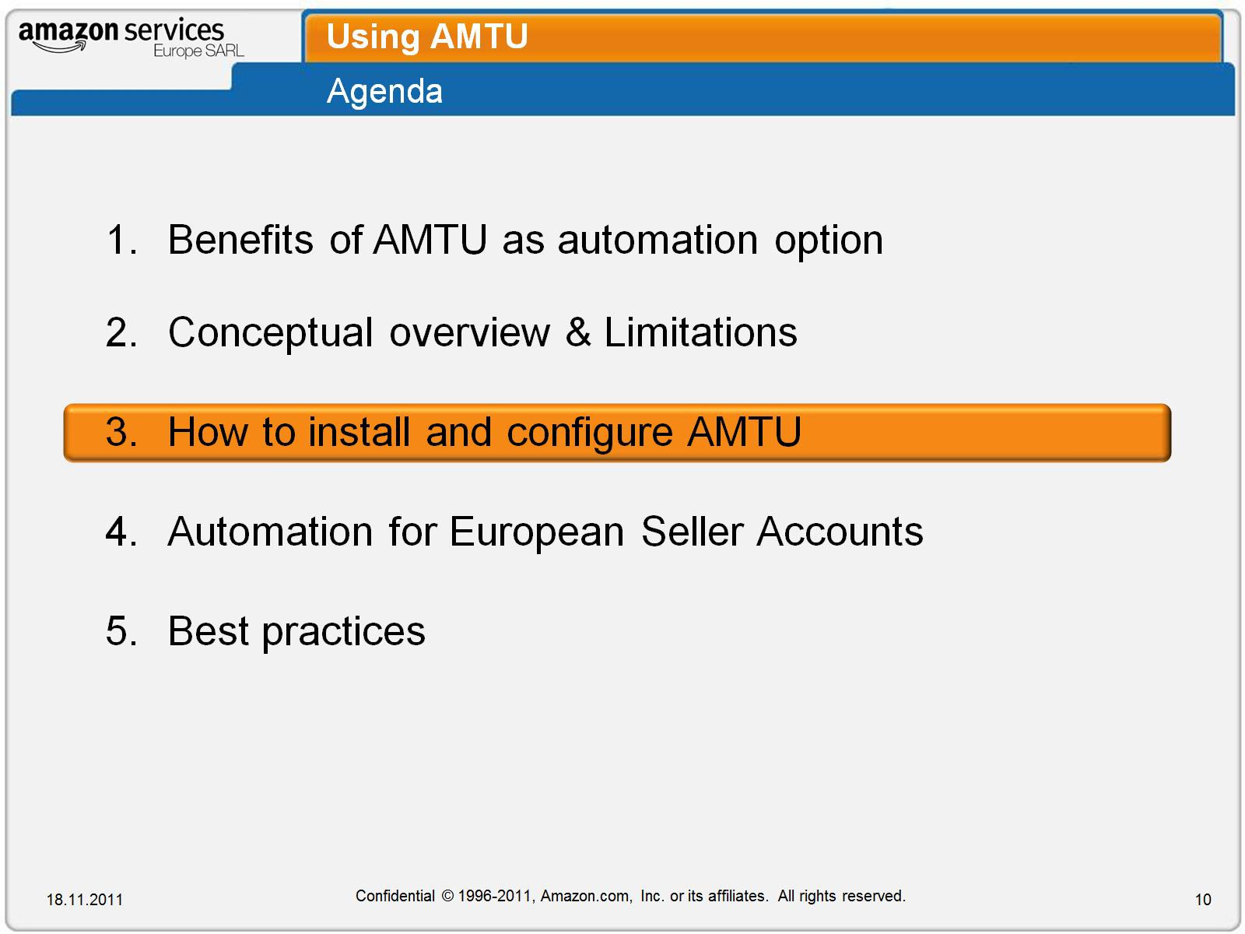
Using AMTU

Slide 11
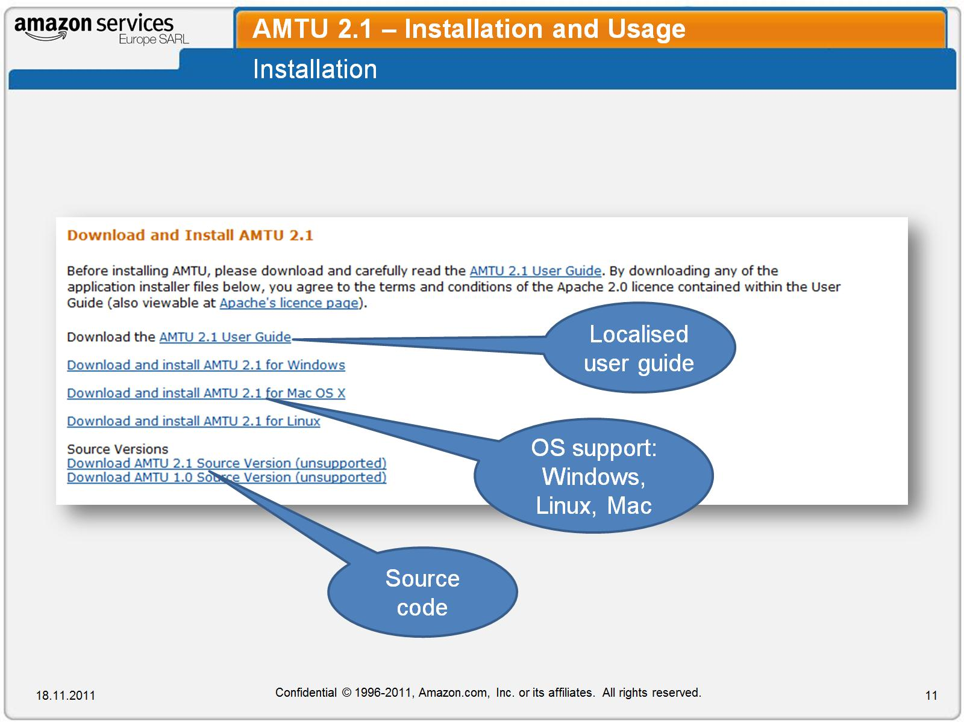
AMTU 2.1 – Installation and Usage

Slide 12
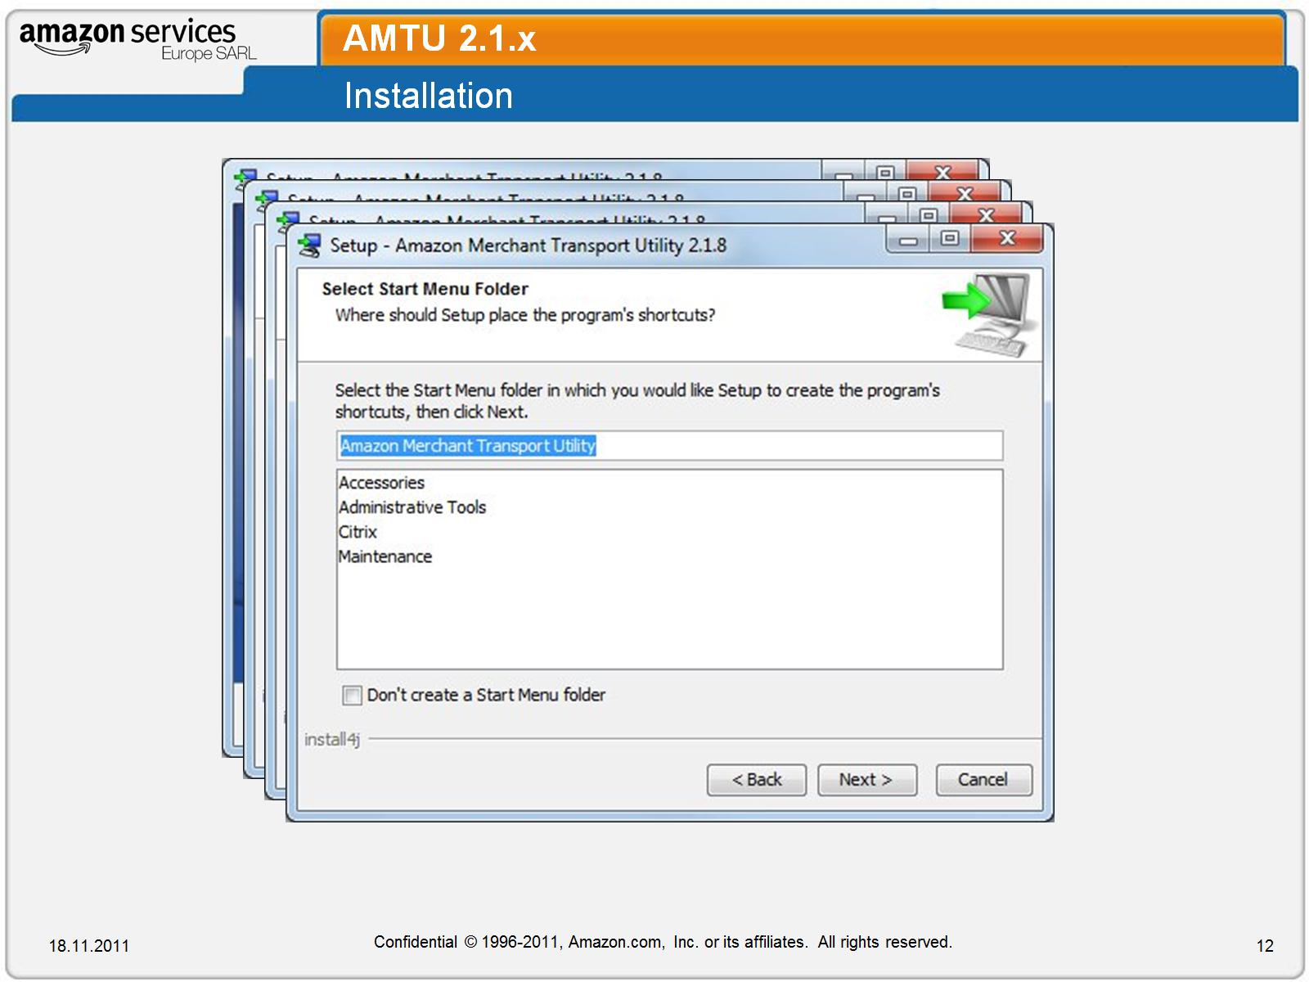
AMTU 2.1.x

Slide 13
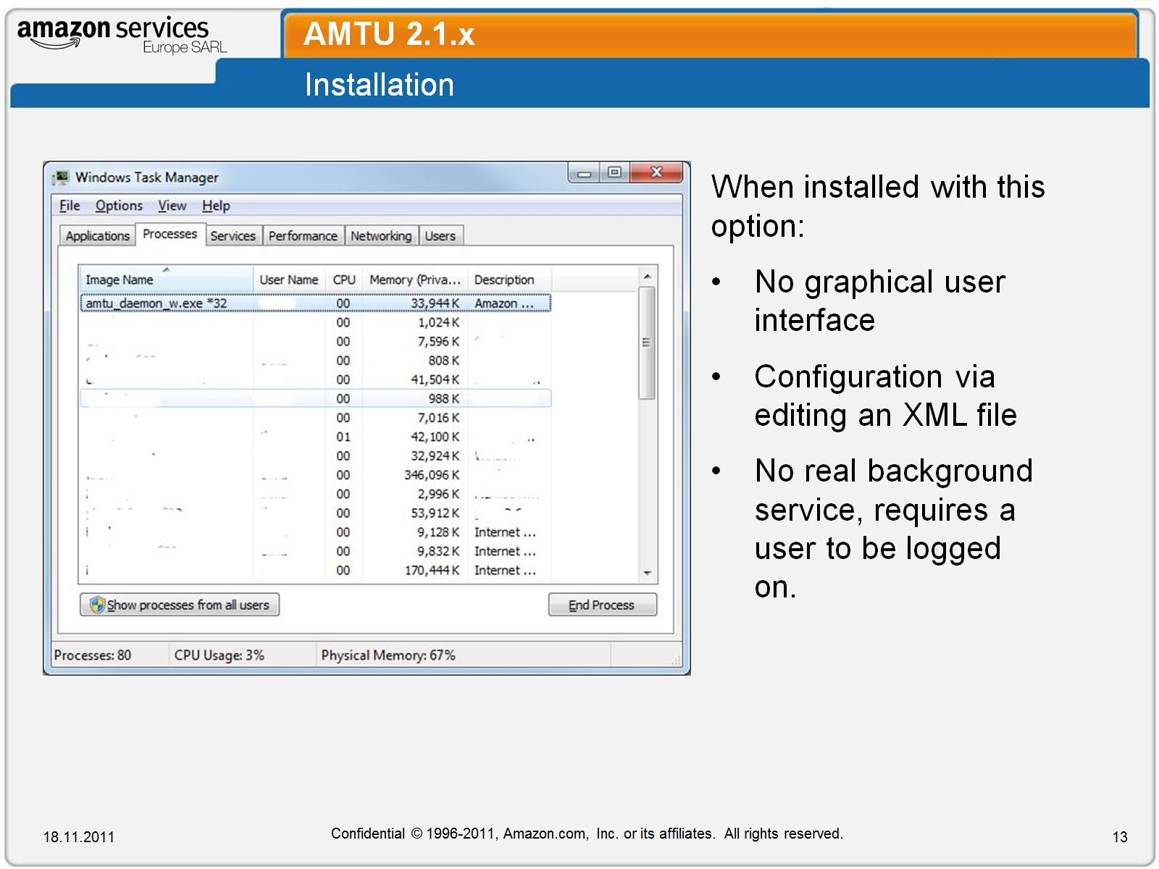
AMTU 2.1.x

Slide 14
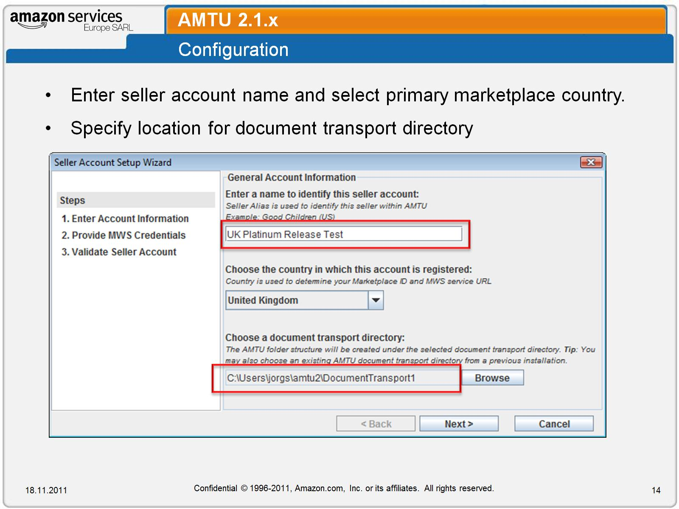
AMTU 2.1.x

Slide 15
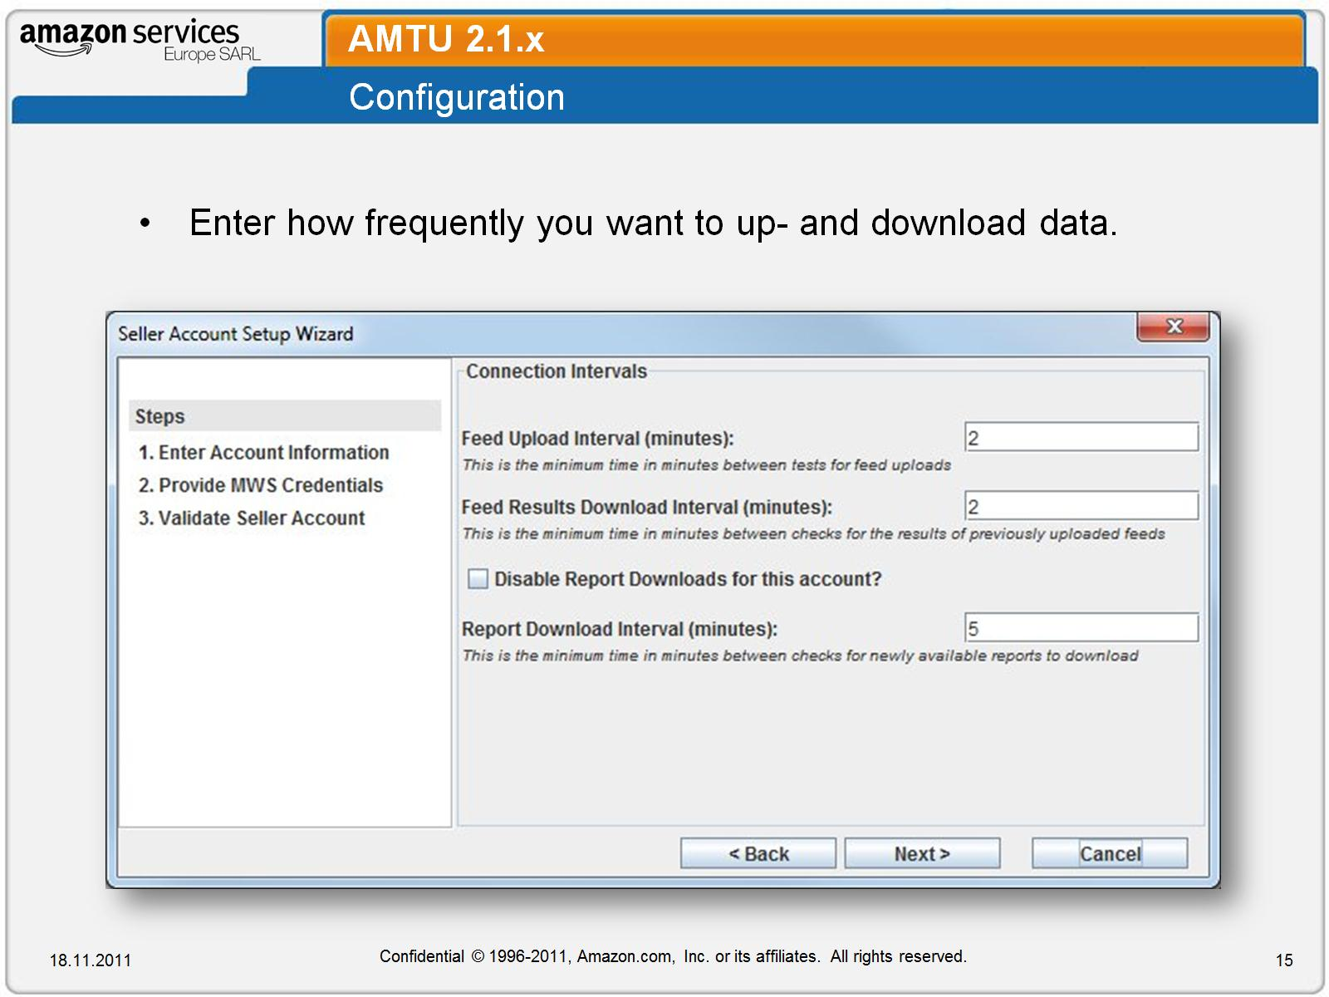
AMTU 2.1.x

Slide 16
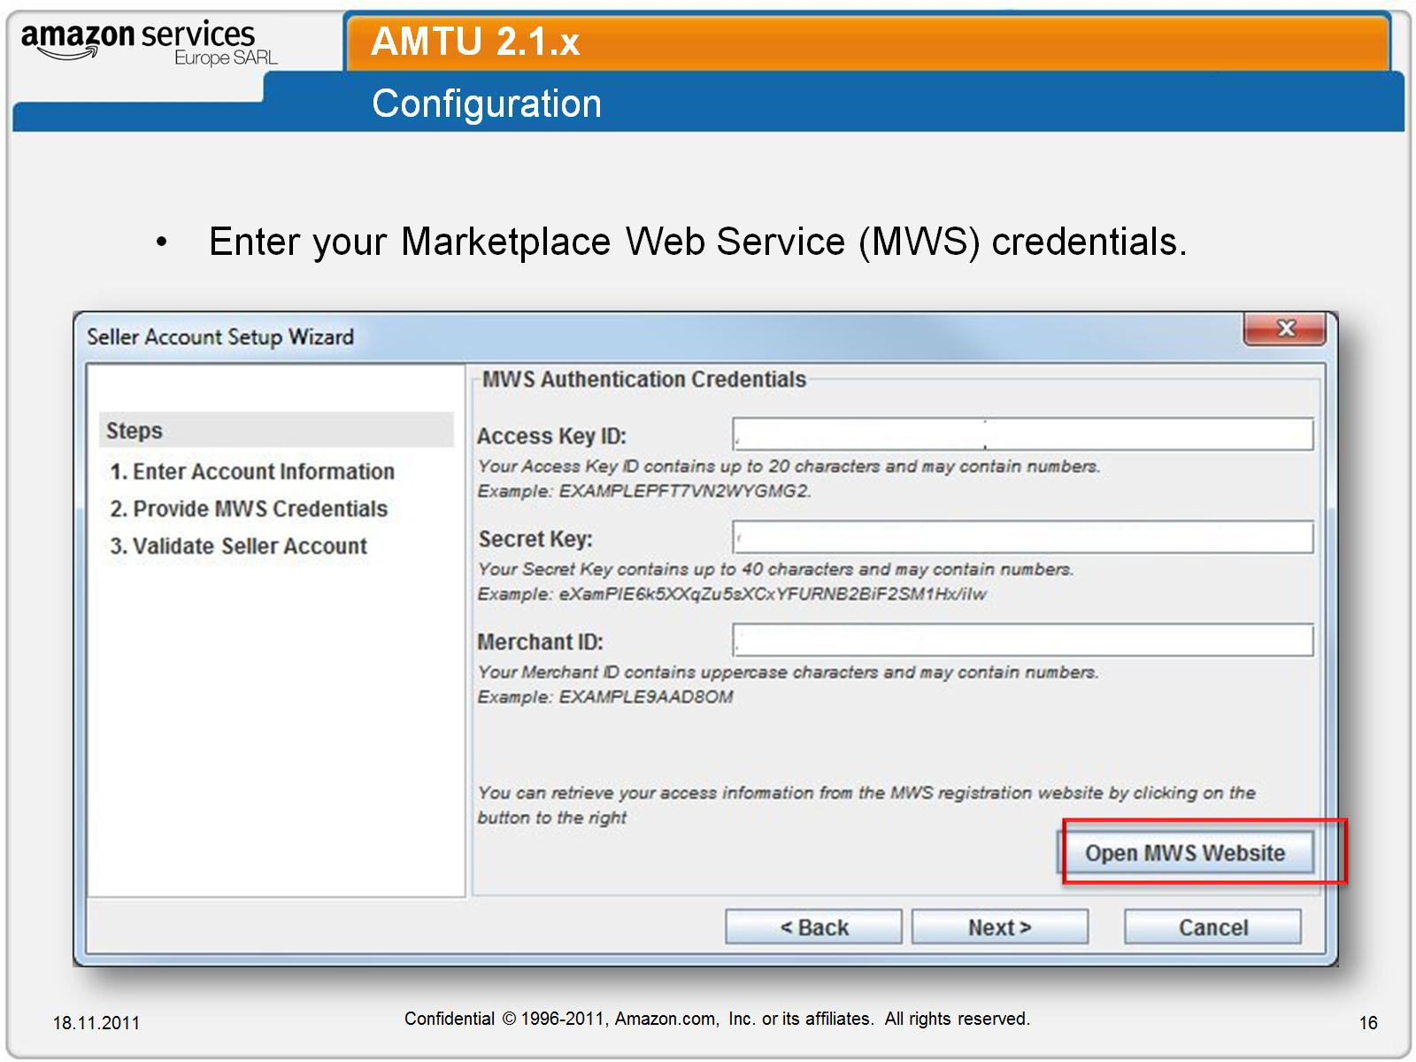
AMTU 2.1.x

Slide 17
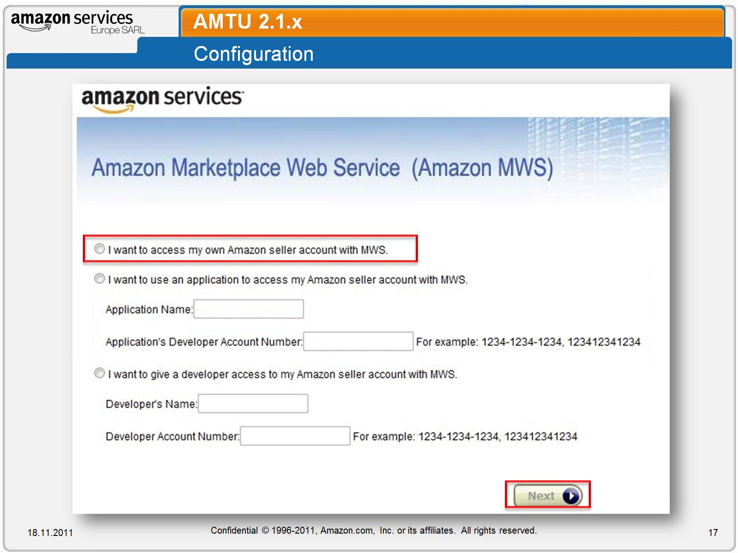
AMTU 2.1.x

Slide 18
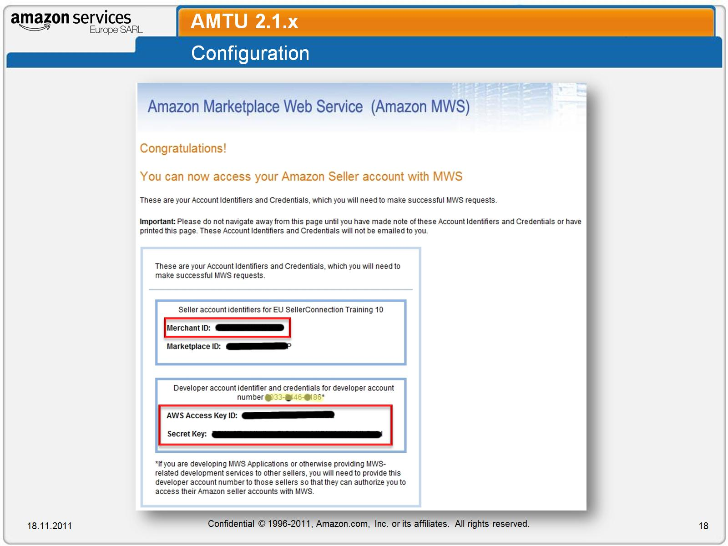
AMTU 2.1.x

Slide 19
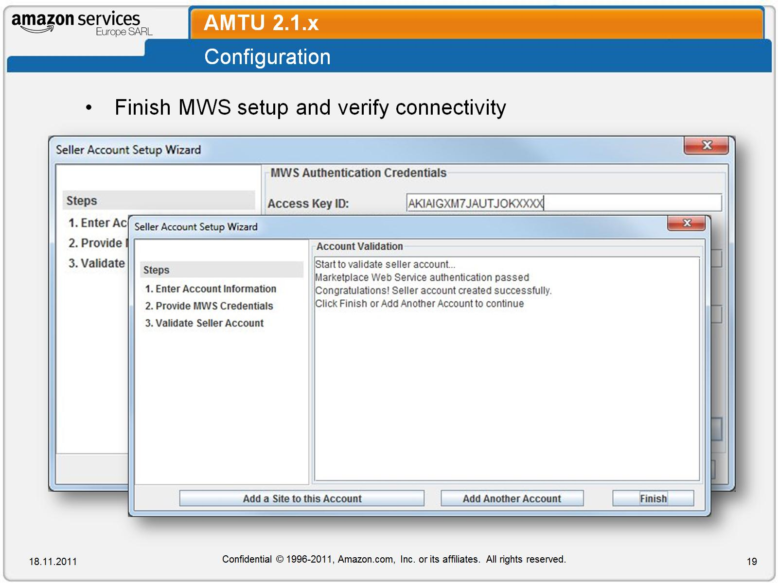
AMTU 2.1.x

Slide 20
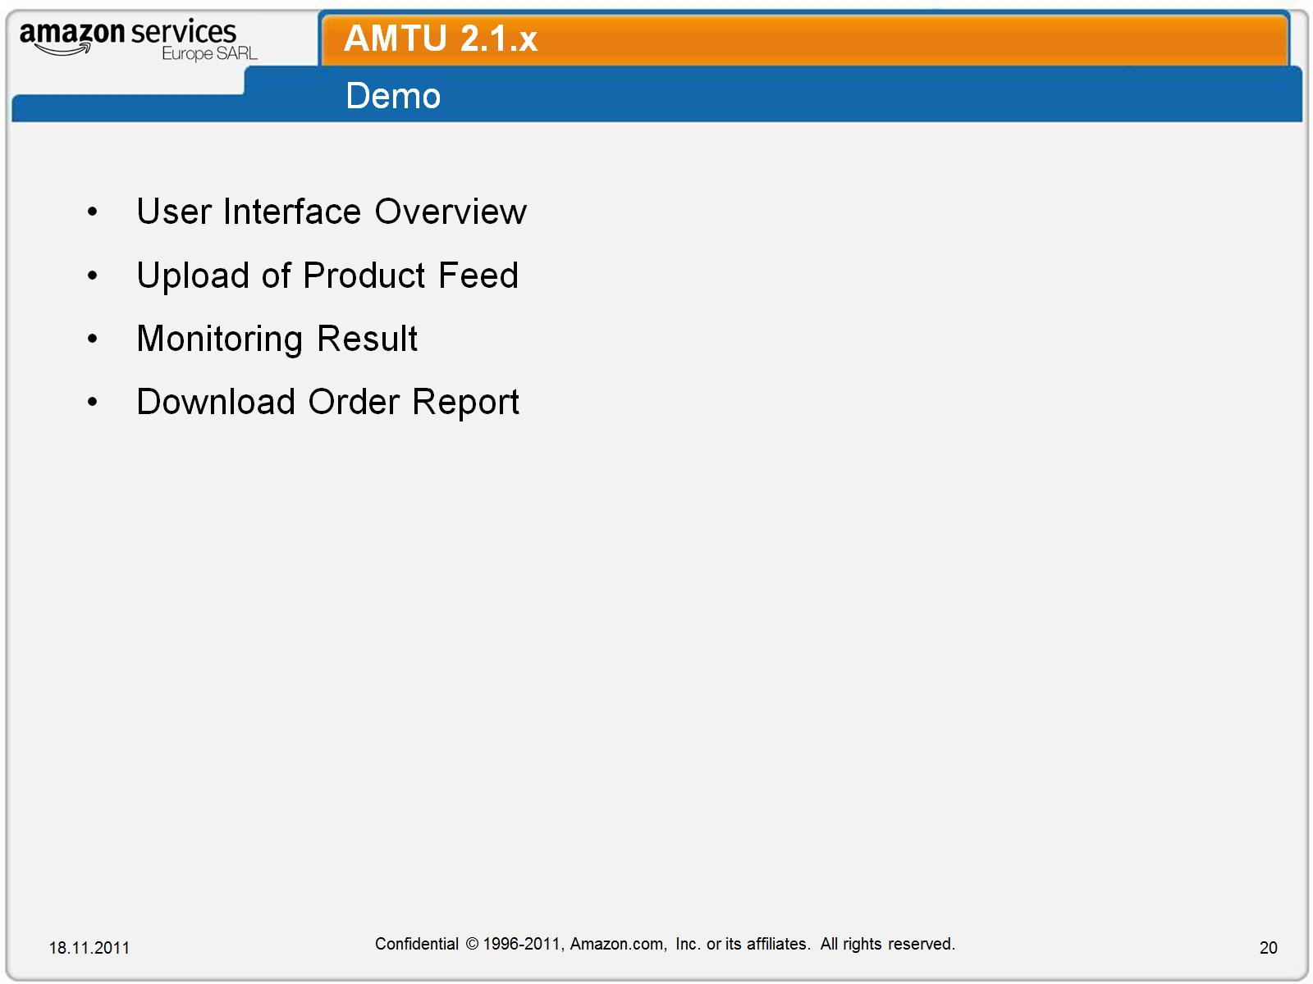
AMTU 2.1.x

Slide 21
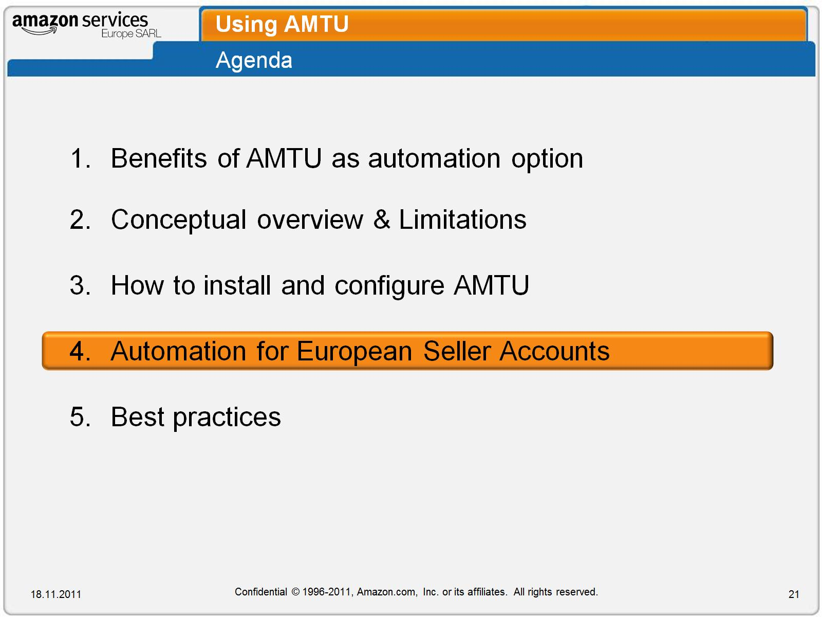
Using AMTU

Slide 22
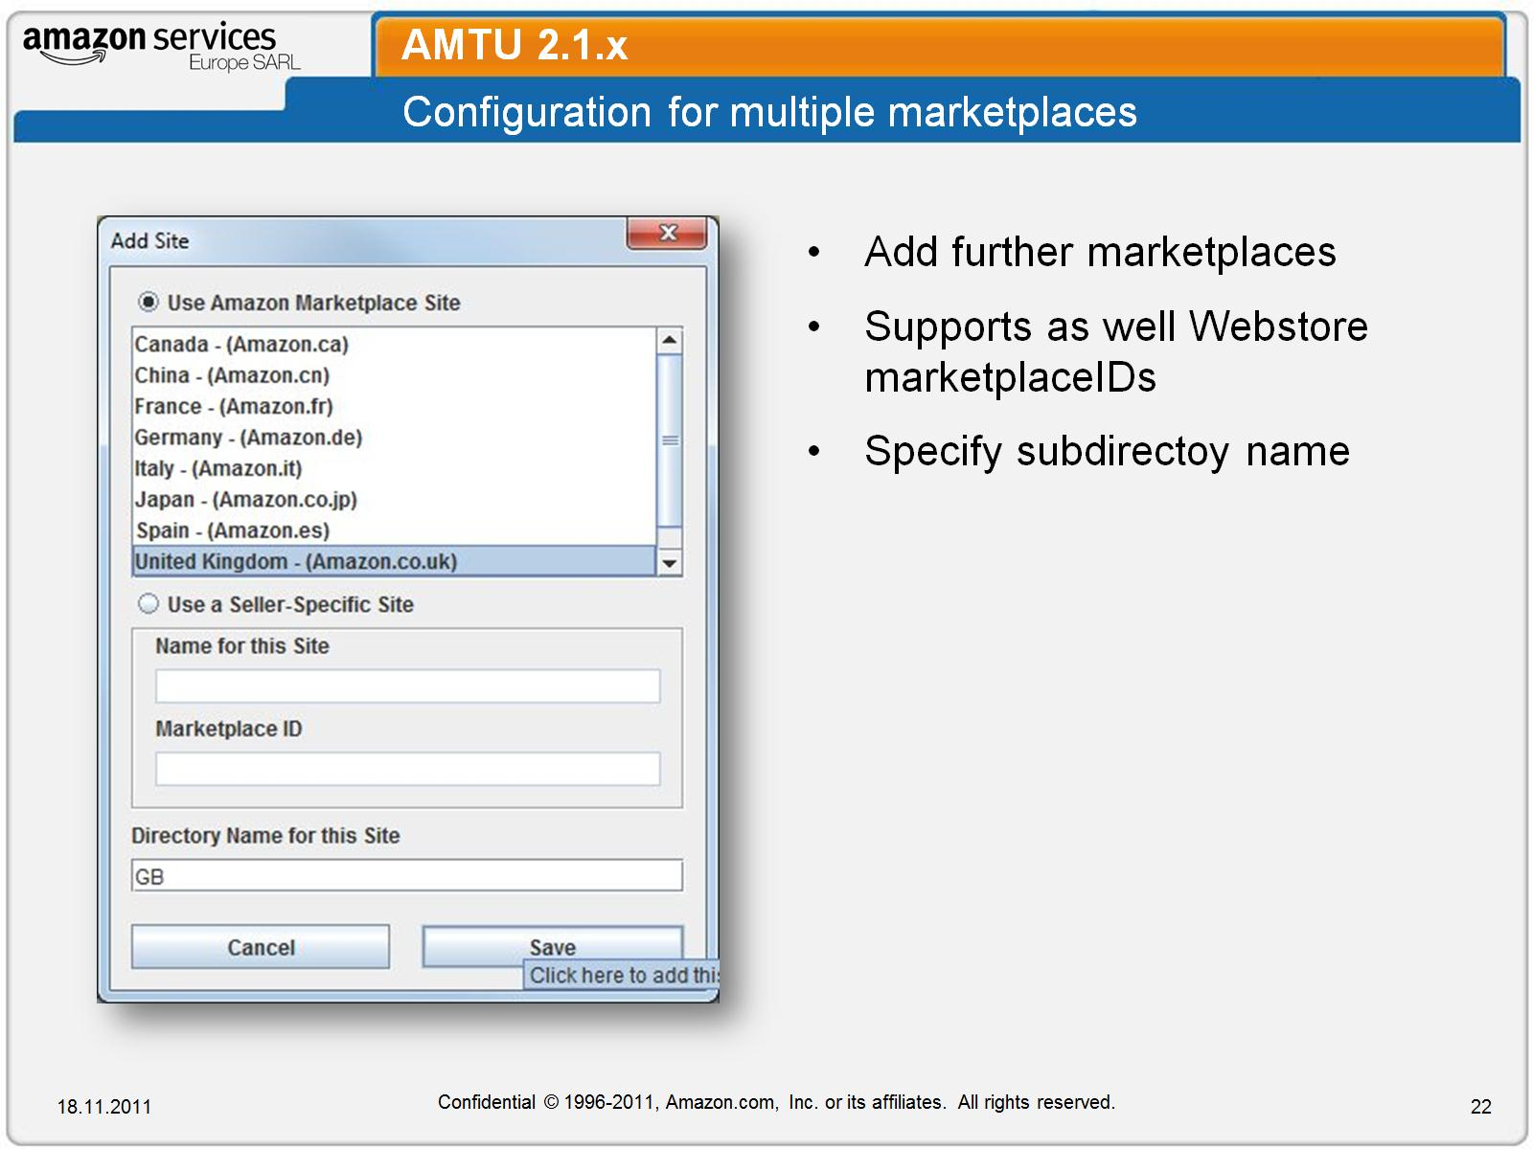
AMTU 2.1.x

Slide 23
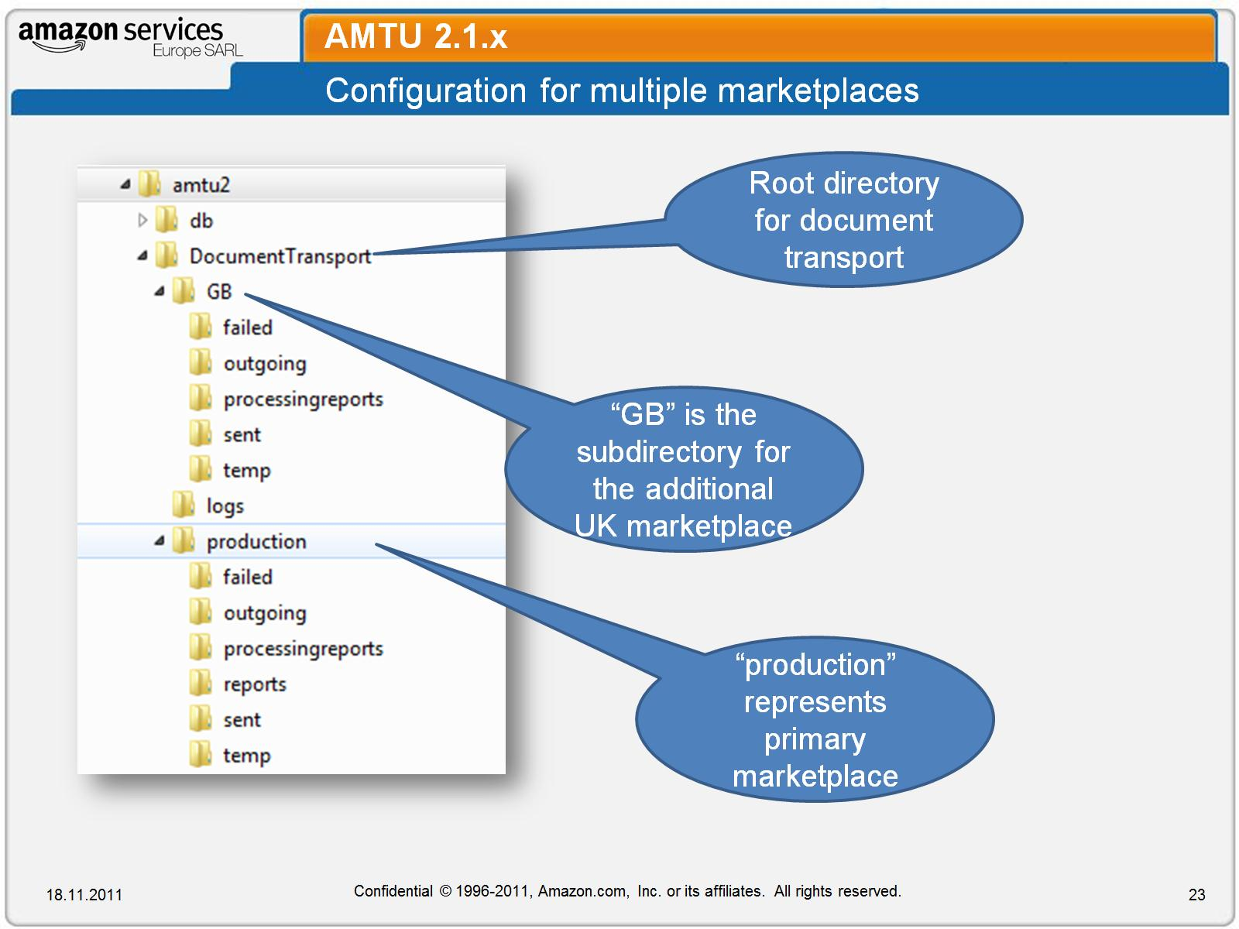
AMTU 2.1.x

Slide 24
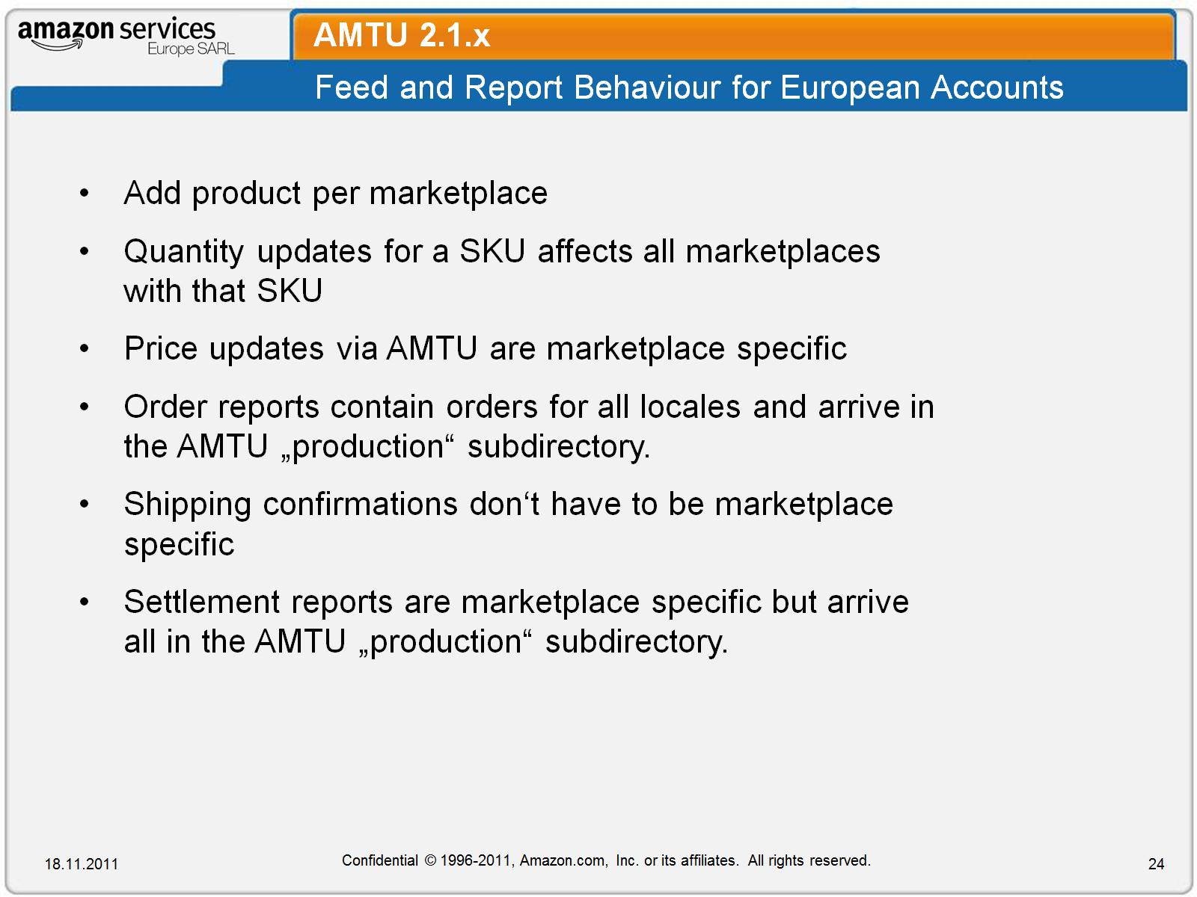
AMTU 2.1.x

Slide 25
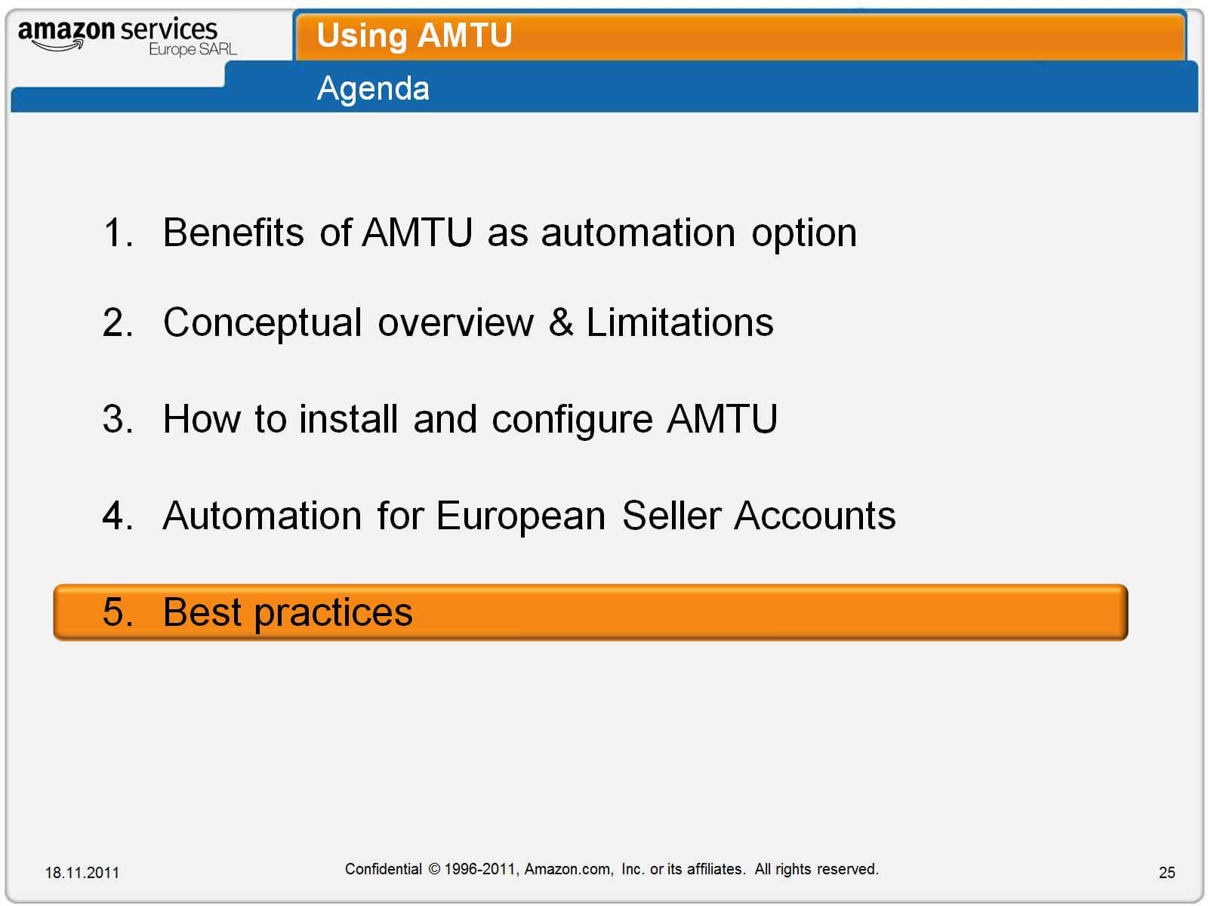
Using AMTU

Slide 26
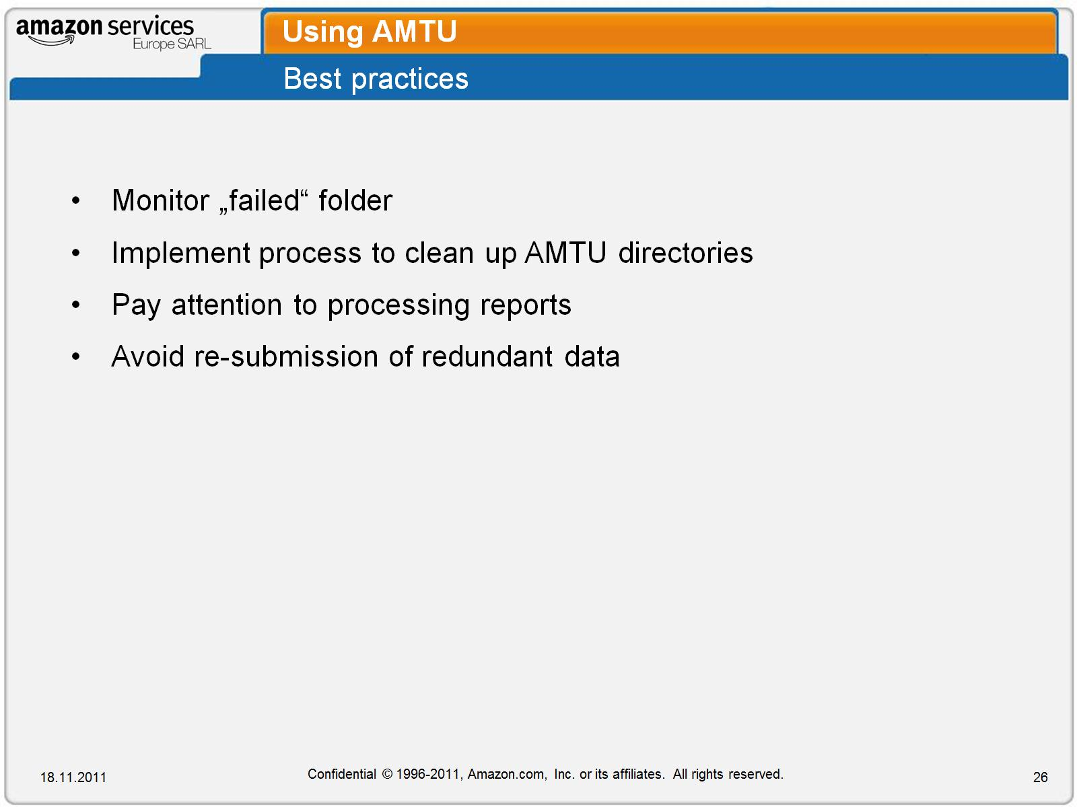
Using AMTU

Slide 27
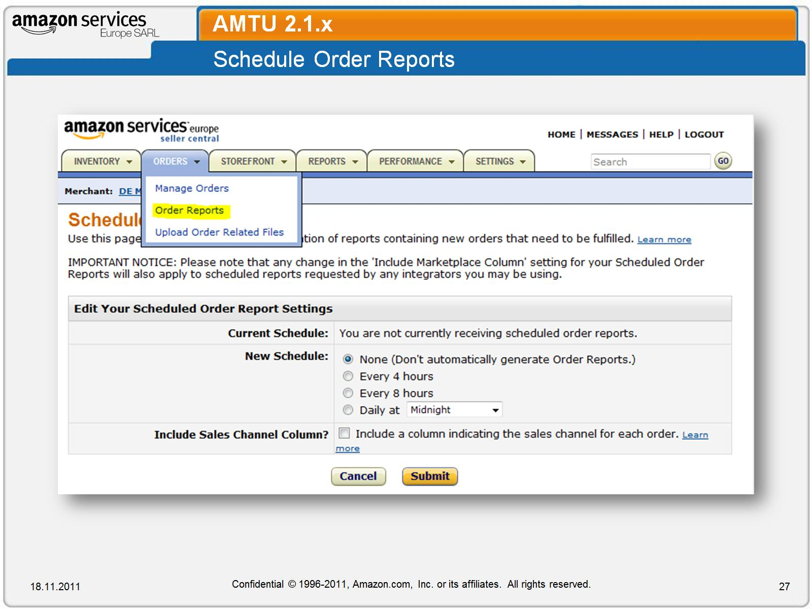
AMTU 2.1.x

Slide 28
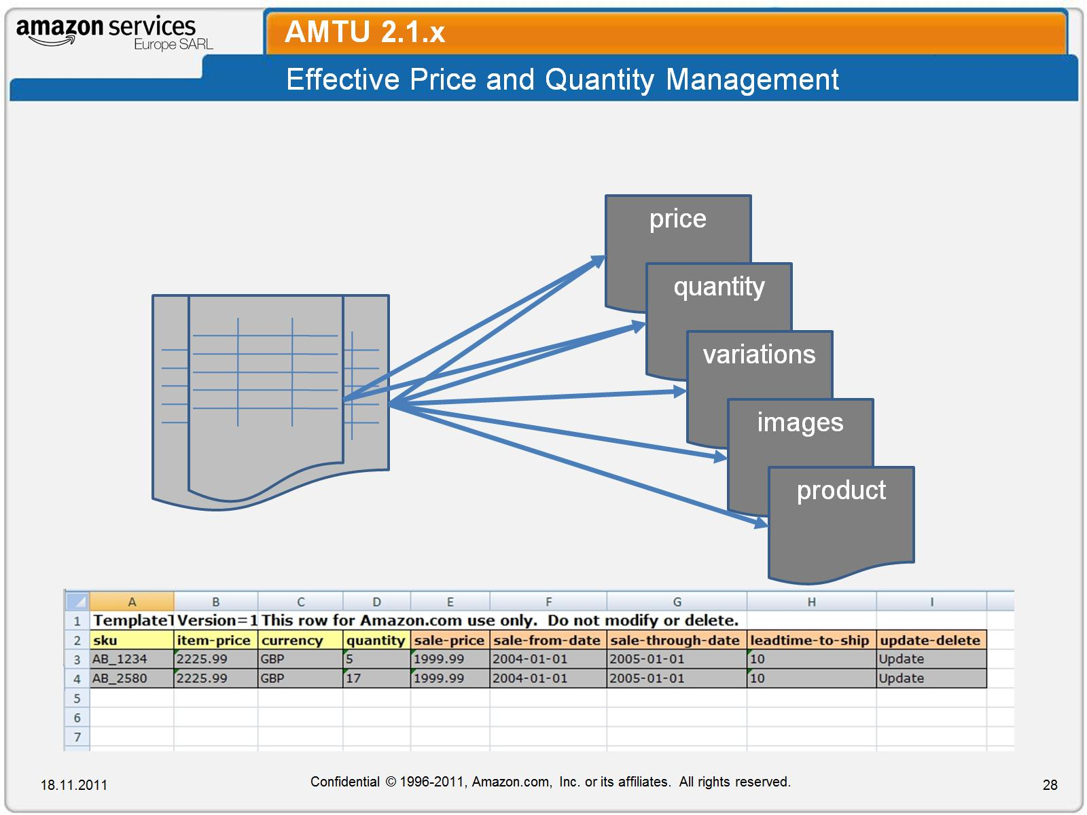
AMTU 2.1.x

Slide 29
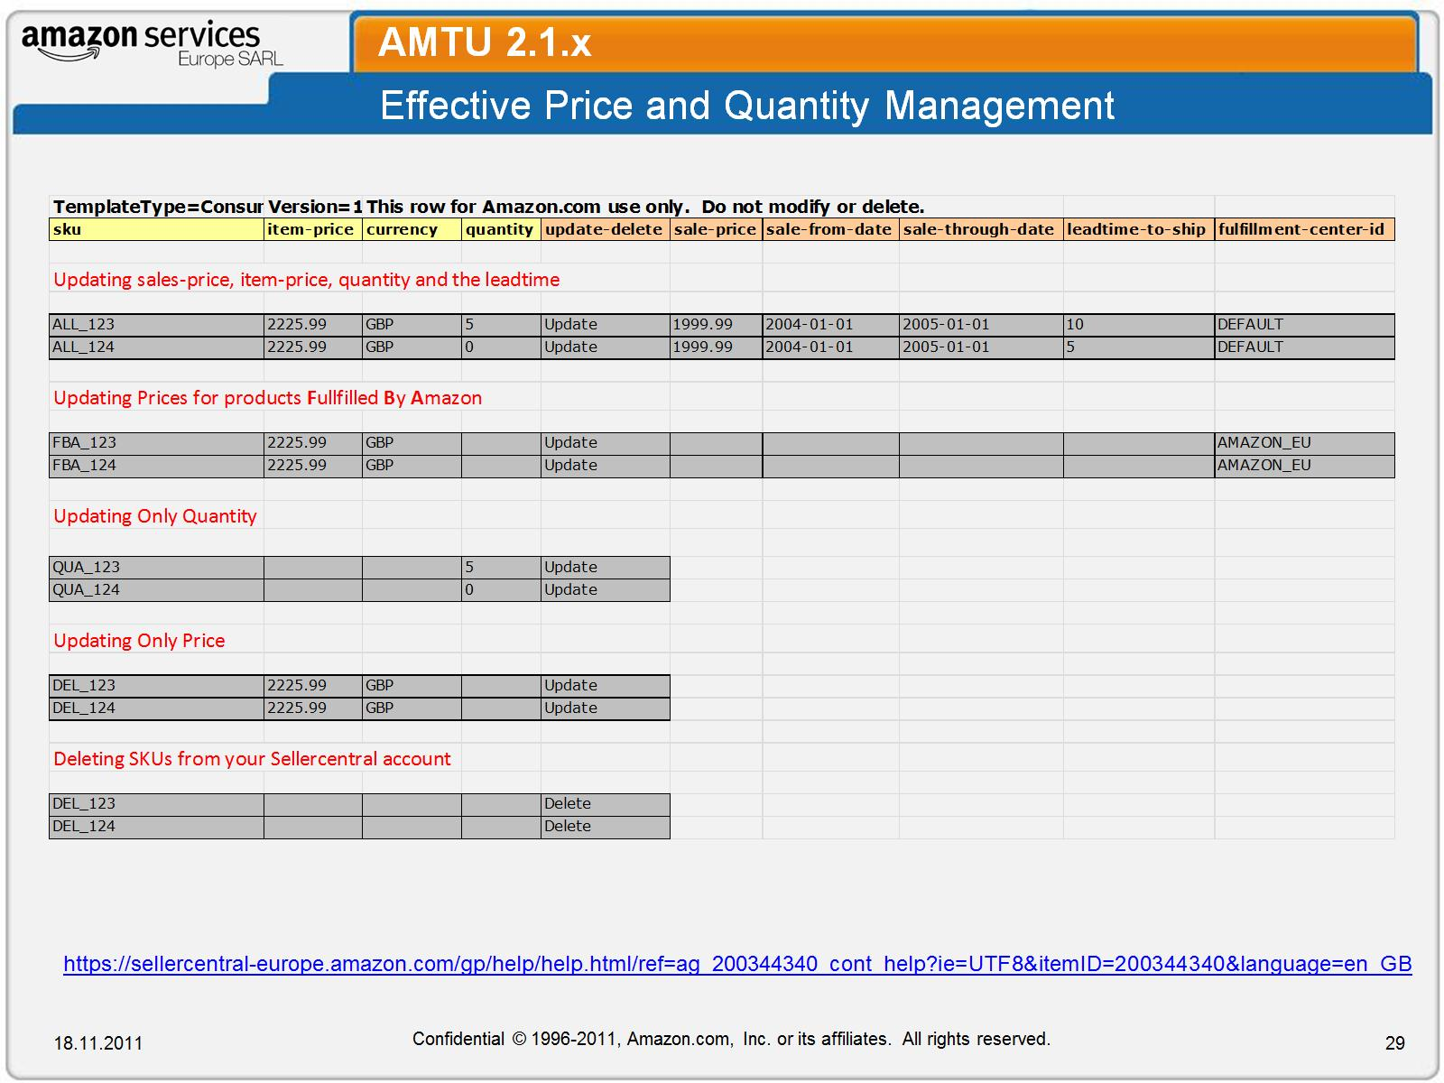
AMTU 2.1.x

