Slide 1
Best Practices to Add Products Smoothly to Your Account
Confidential © 1996-2011, Amazon.com, Inc. or its affiliates. All rights reserved.

Slide 2
Agenda
What are the main methods to list on Amazon.co.uk?
How to bulk upload products in your Seller Central account?
Live Demo
Most Frequent Errors
Q&A
Useful References

Slide 3
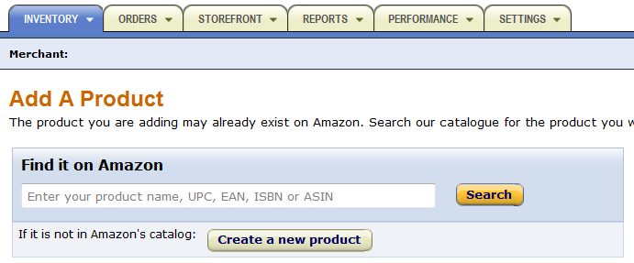
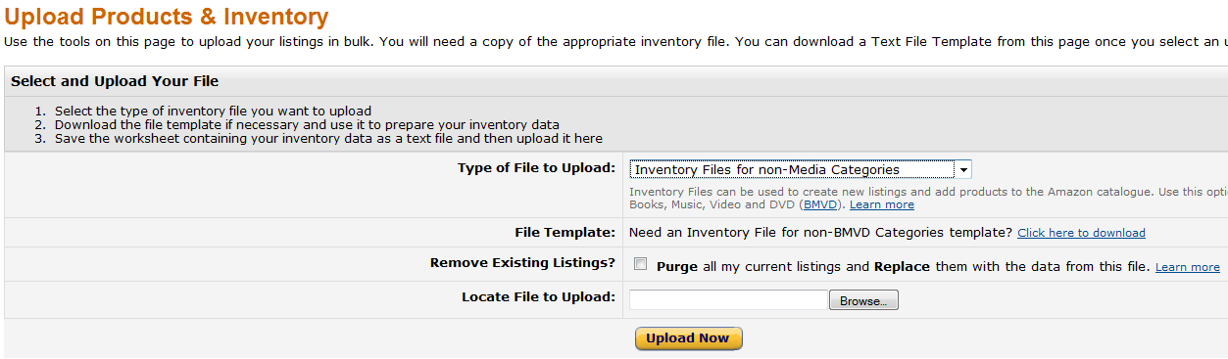
What are the main methods to list your offers?
Your Seller Profile | Recommended Method
Small Inventory (ex: <100 products), basic technical skills | ‘Add a Product’ one by one:
Medium to large inventory, knowledge of Excel and Text | ‘Upload Products & Inventory’ using inventory files:
Large inventory (ex: >10,000), good knowledge of XML, Java and other programming languages | Automation through ‘Marketplace Web Services’ APIs: https://developer.amazonservices.co.uk/index.html

Slide 4
Why use bulk upload/feeds?
How to bulk upload products in Seller Central?
What are ‘Feeds’ or ‘Flatfiles’?
Feeds are the inventory files you upload in your seller account to create or modify your listings.
There are different templates for different product categories.
Why should you use feeds and not add products one by one?
Time-Saving: this allows you to easily upload a large number of products into Seller Central.
Better Accuracy: you are less likely to make mistakes in your product information if you have to create hundreds or thousands of products at once.
More Details: you can more easily add all the details required about your products. Your buyers will be able to make an informed purchase: This can increase your sales and/or reduce order defects.

Slide 5
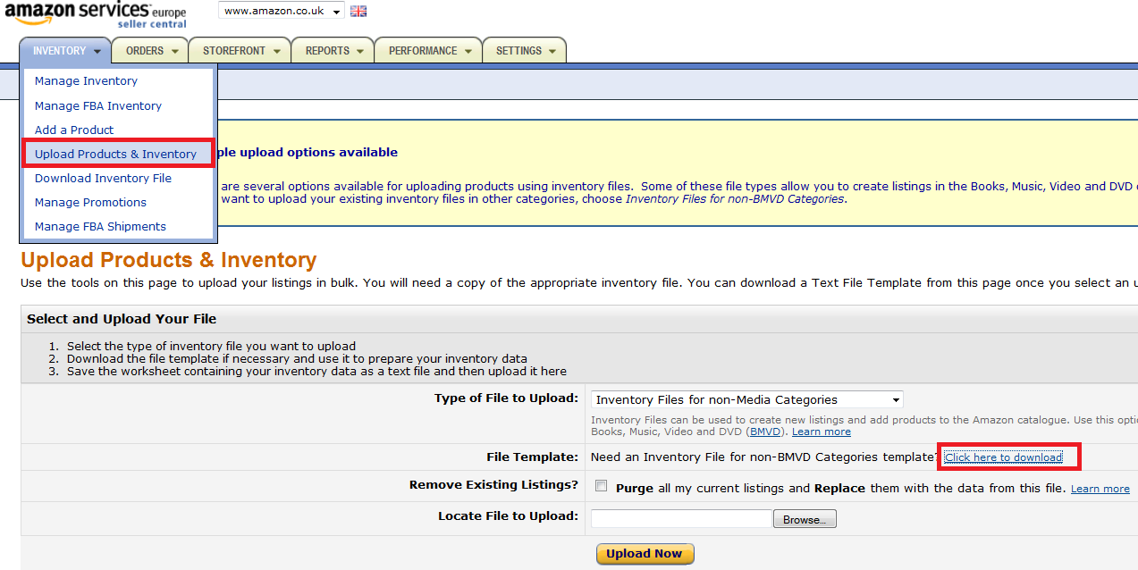
What are the different kinds of feeds?
How to bulk upload products in Seller Central?
The different templates are available in the ‘Upload Products and Inventory’ section:

Slide 6
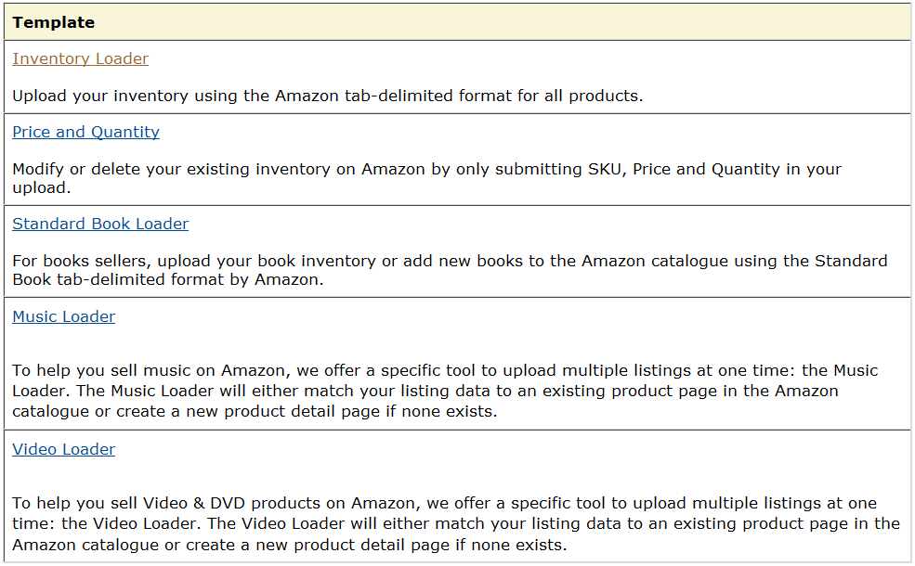
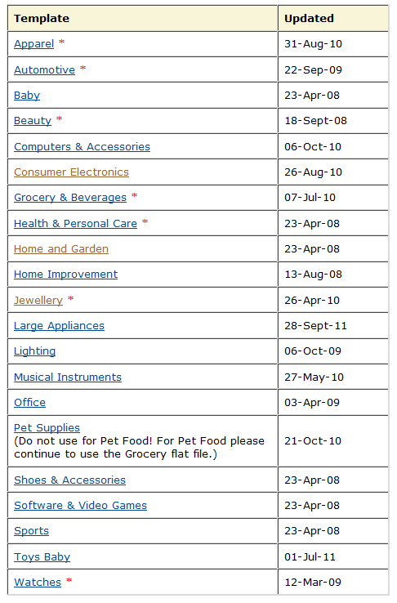
What are the different kinds of feeds?
How to bulk upload products in Seller Central?
The different templates are available in the ‘Upload Products and Inventory’ section:
Use the simplified ‘Inventory Loader’ template for products which already exist in the Amazon catalogue
For Non-Media, use the ‘Inventory File Templates’ to create new products from scratch, with all required information, in the Amazon catalogue

Slide 7
How to work on templates
How to bulk upload products in Seller Central?
Mandatory Information:
SKU
Product ID (Barcode)
Product ID Type
Title
Brand and/or Manufacturer
Item Price
Currency
Quantity
Browse Nodes
Bullet Points
Description
Search Terms
Main Image URL
Parenting Information

Slide 8

Data definitions & valid values tabs
How to bulk upload products in Seller Central?
Tip: Refer to the Data Definitions and Valid Values tab continuously while working on the flat file.
Data Definitions Tab: Gives you an explanation of the kind of data that should go into each field in the template.
Valid Values Tab: Gives you the list of allowed values for certain fields in the template.

Slide 9
Agenda
What are the main methods to list on Amazon.co.uk?
How to bulk upload products in your Seller Central account?
Live Demo
Most Frequent Errors
Q&A
Useful References

Slide 10
Most Frequent Errors
Incorrect File Format: you did not save your file as a ‘Tab Delimited Text’ file, or you deleted the header rows or you uploaded the wrong template.
Restricted Category: if you want to list in a restricted category (ex: Apparel), you need to obtain prior approval before you can upload your products.
Matching Error: your product title or description corresponds to another product in the Amazon catalogue than the ASIN you indicated.
Invalid Values: you did not follow the correct format. For example, you put a decimal comma instead of a decimal point in the price column.
Fulfilment Channel: for FBA products, you must leave the Quantity column empty and select ‘Amazon_EU’ as Fulfilment-center-id.
Listing in another marketplace: if you list via the European Account in another Amazon Europe marketplace, you need to use the template of the local marketplace where you want to list your products.

Slide 11
Q&A

Slide 12
Useful References
Text File Templates
Browse Tree Guides
Style Guidelines
Building an Inventory File Video Tutorial
Creating Variations with a Flatfile Video Tutorial
Managing your Inventory in the Europe Marketplaces Account Video Tutorial
Upload Your Inventory File
Review My Inventory Results
Webinar Invitations and Recordings

Slide 13
Thank you for attending!
http://services.amazon.co.uk/resources/events-webinars/

